Slide 1
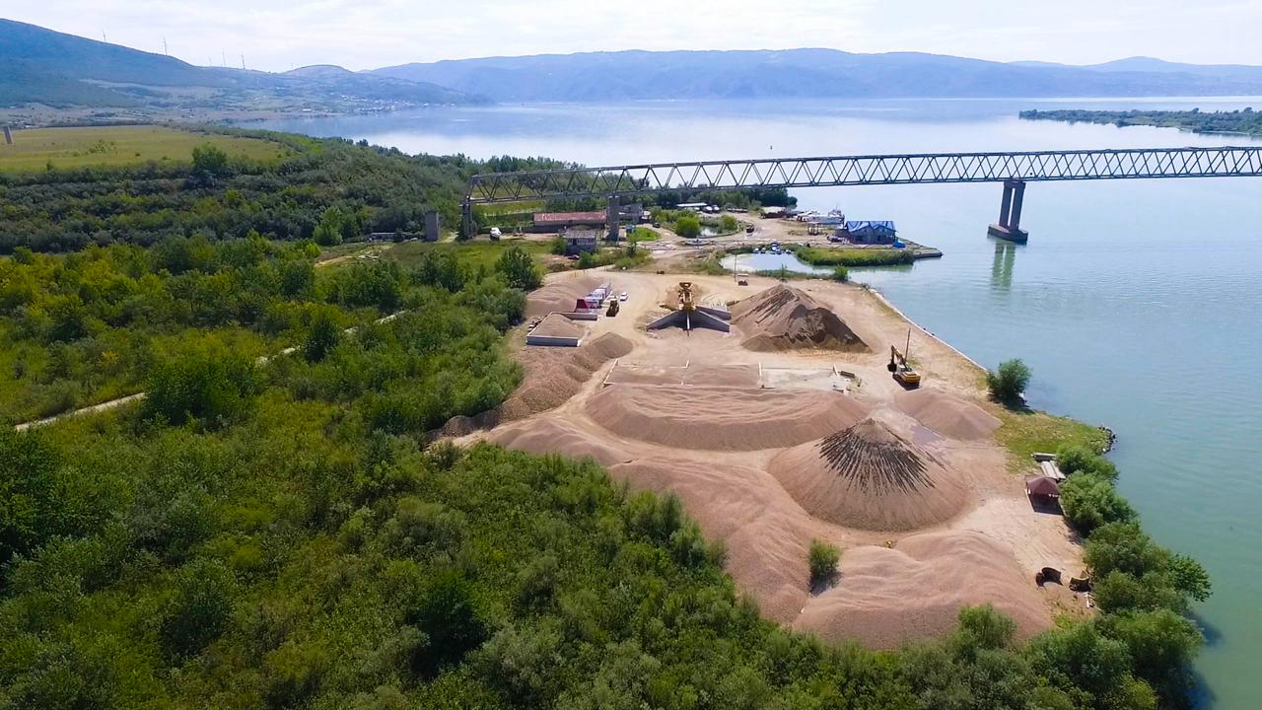

One Year of Environmental Monitoring in the Romania-Serbia Cross-Border Mining Area - Moldova Nouă Case Study
Narcis DUȚEANU, PhD, researcher
Narcis.duteanu@upt.ro
data: 31.08.2026

Slide 2
Sampling Conducted
WATER
General parameters
SOIL
ICP-MS and ion chromatography (metals, anions)
General parameters
ICP-MS for metals
AIR
General parameters
ICP-MS for metals
Moldova Nouă
ENVIRONMENTAL CHARACTERIZATION
Tăușani Boșneag
Notes:
The water and soil samples collected during IV period of this project to VII period of this project were analyzed using specific methods.
We monitored the physical and chemical parameters specific the environmental factors, water,soiland air, with the analytical methods tailored to each parameter. The aim of this study was to characterize the environment in the Moldova Noua area, a region known for the mining of Cu(II) deposits, which is currently closed.

Slide 3
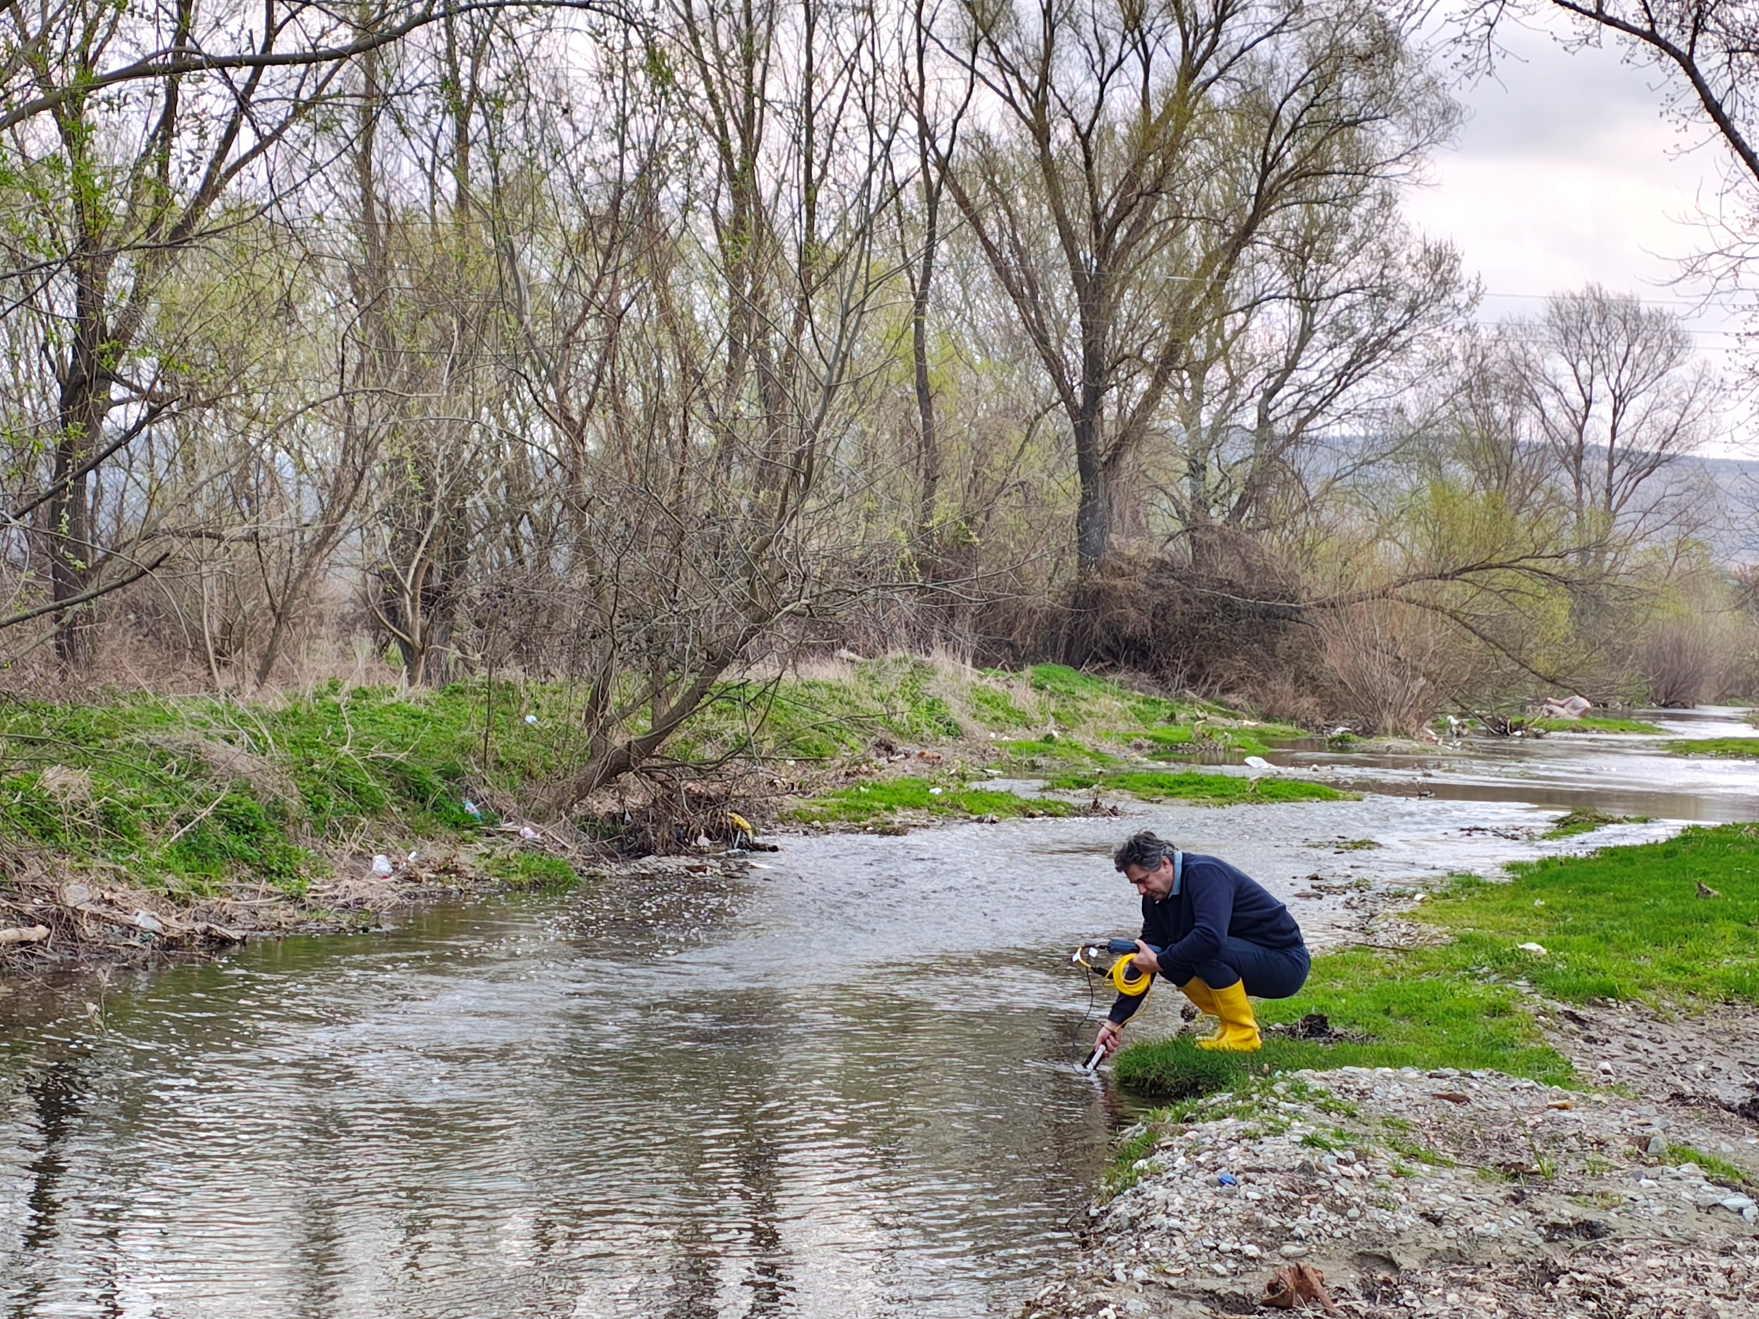
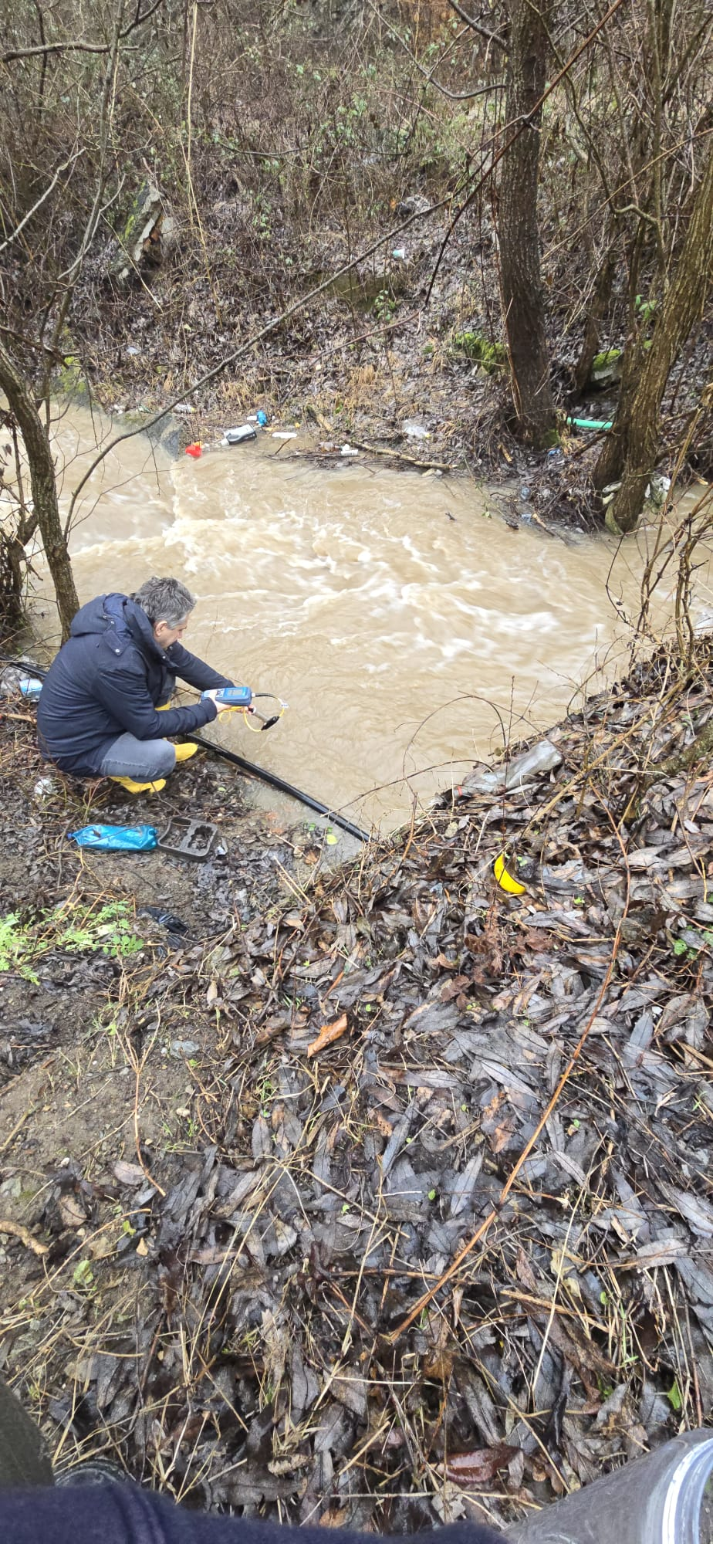
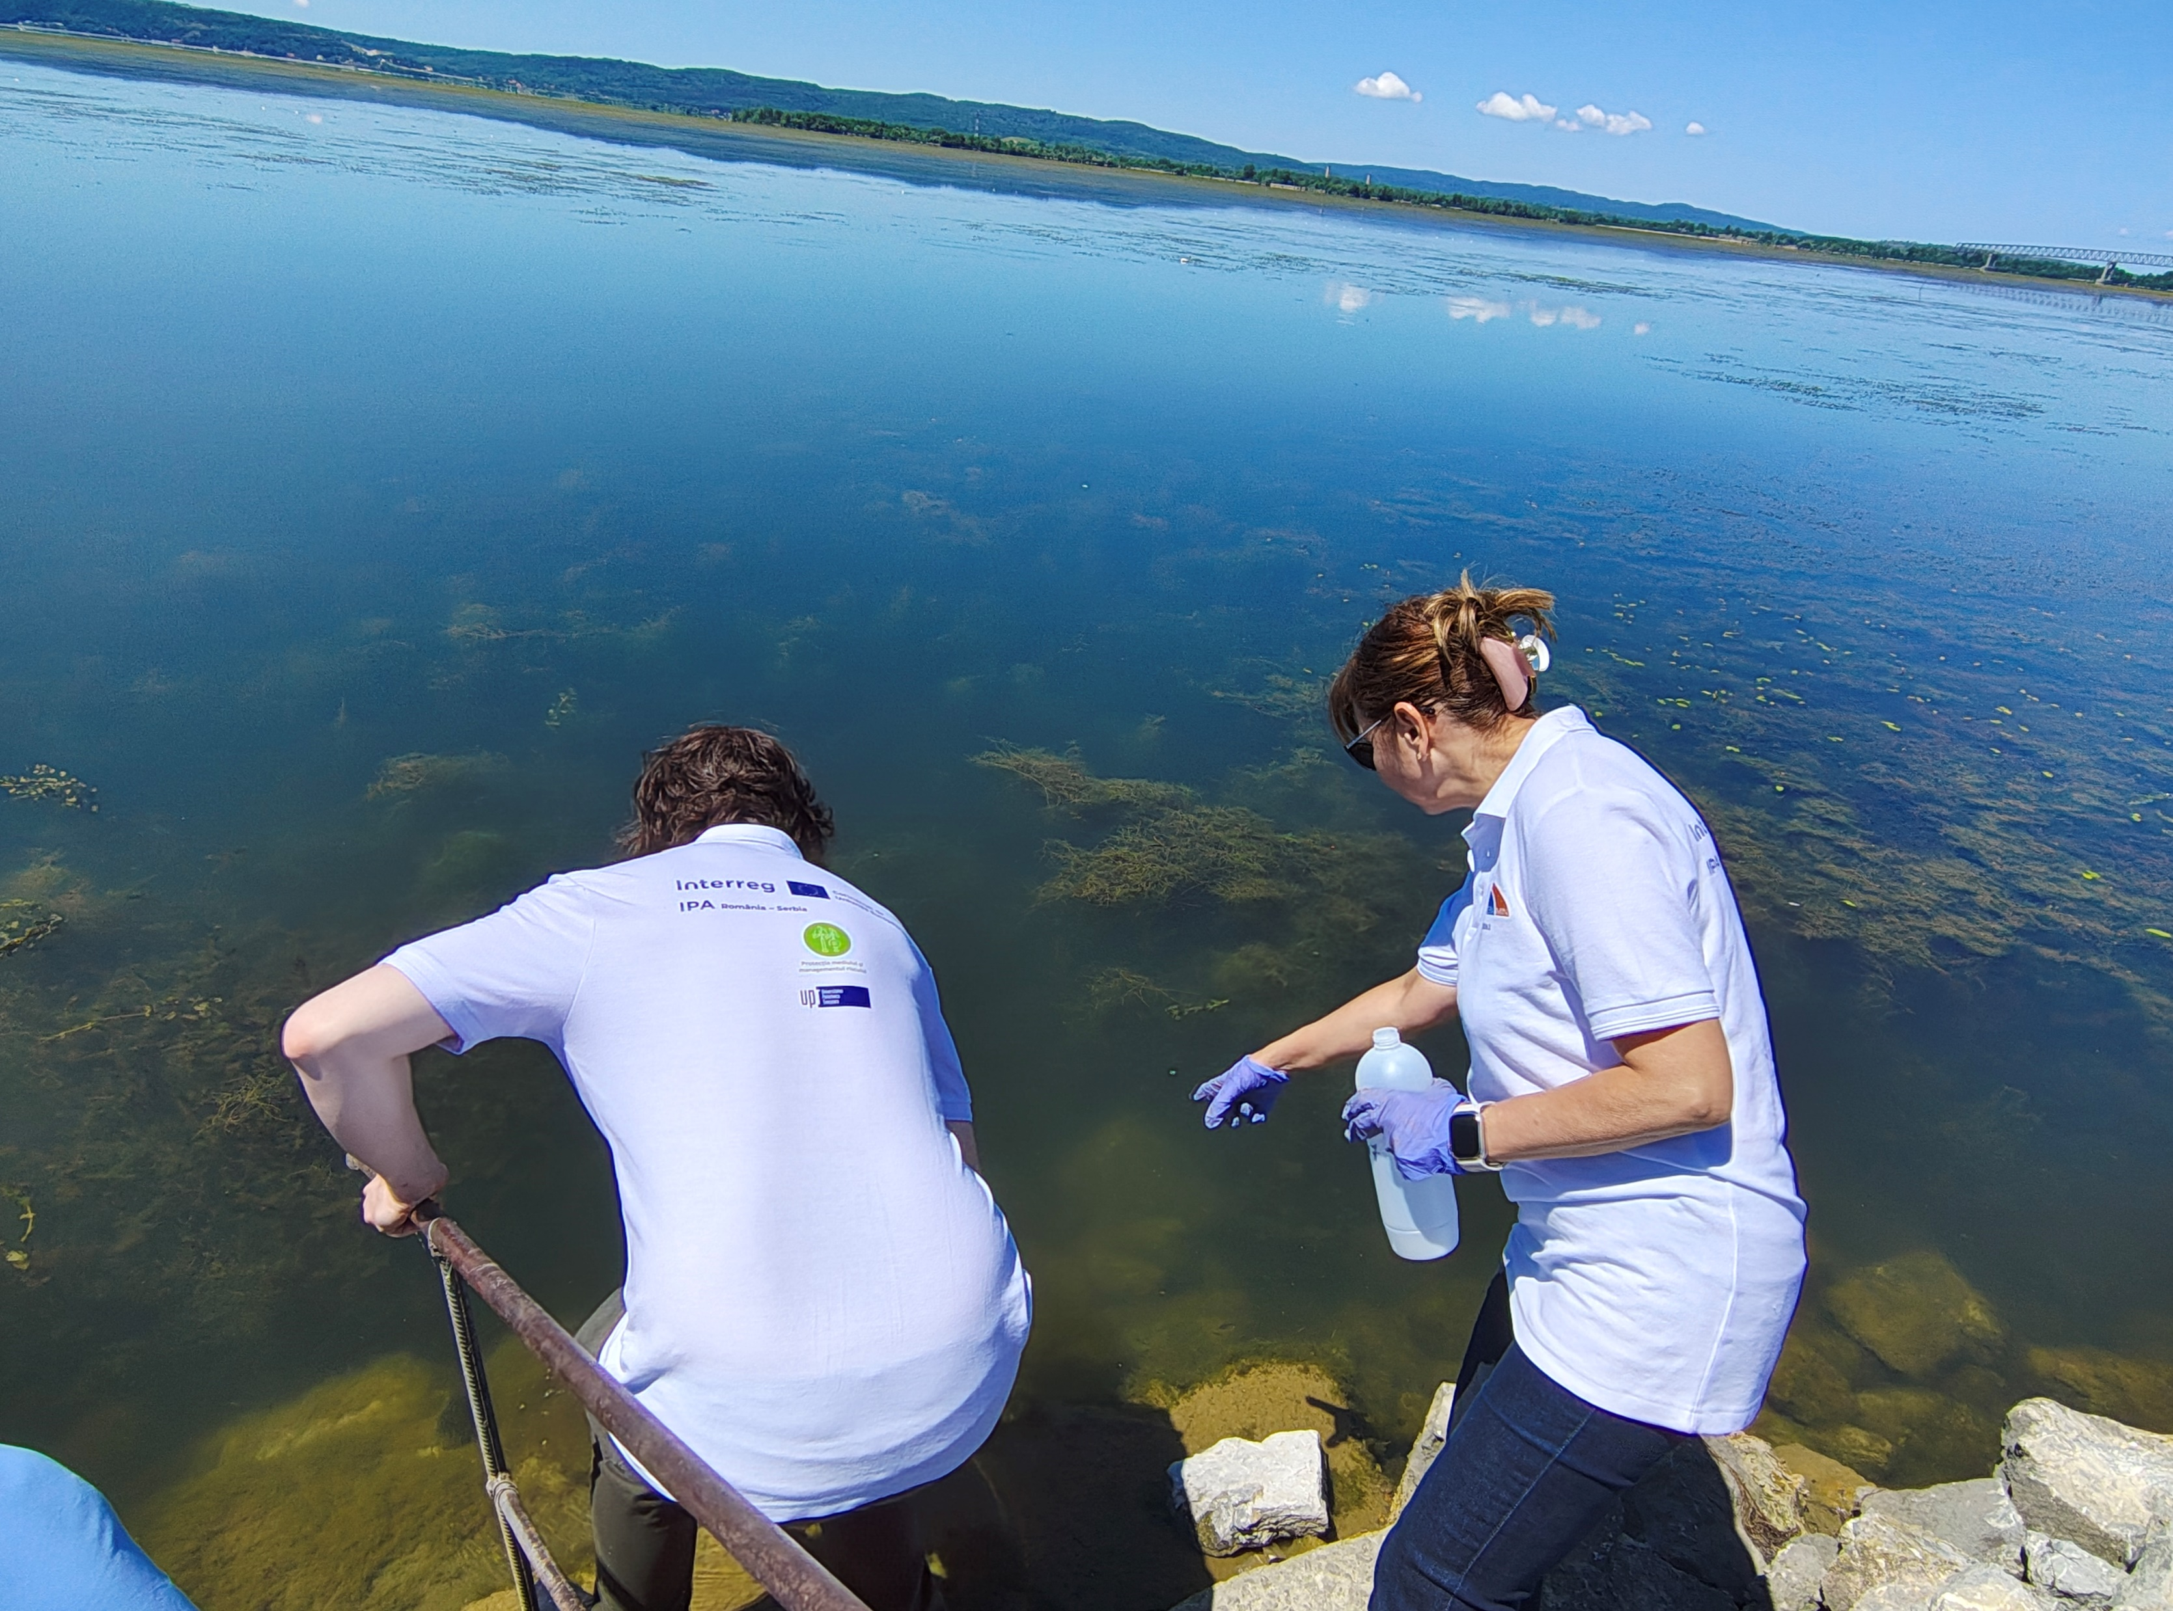

MATERIALS AND METHODS
FIELD WORK
W1
W5
W7
Spring
Notes:
Water and soil samples were collected from 10 locations around the tailings pond.

Slide 4
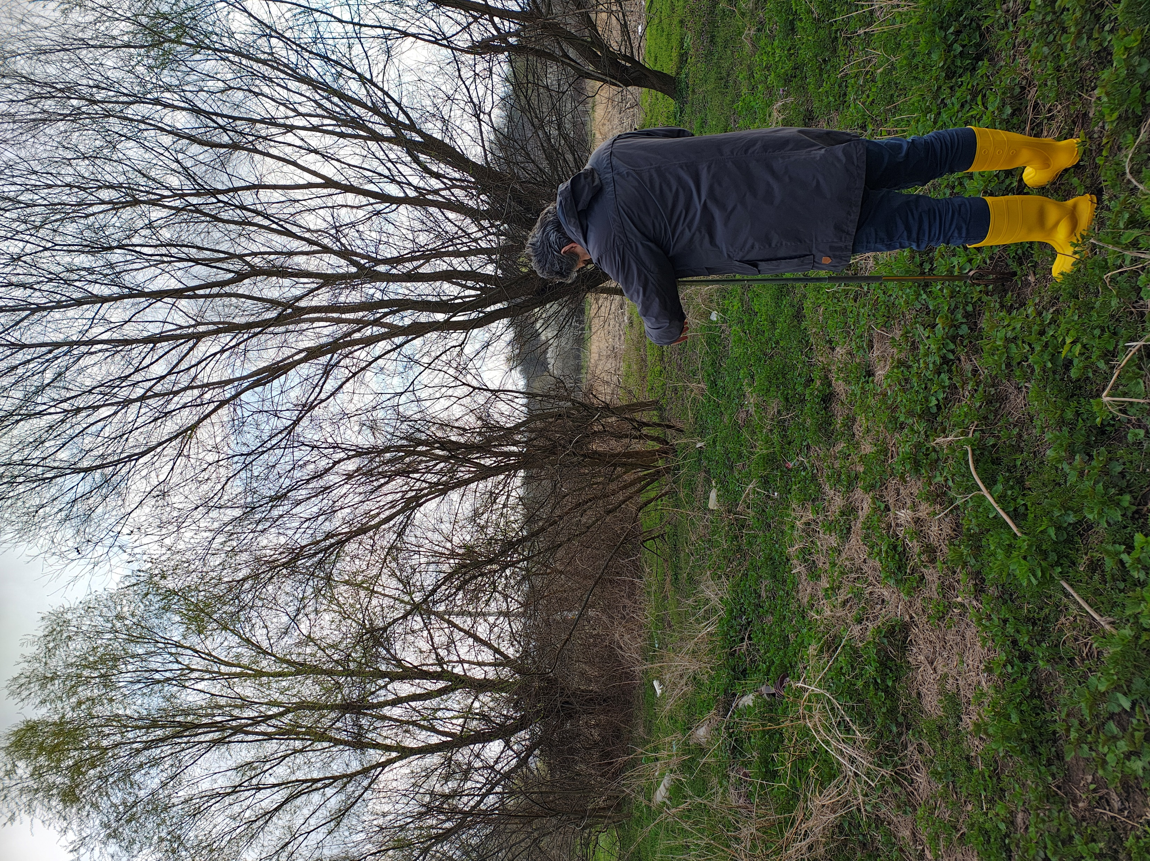
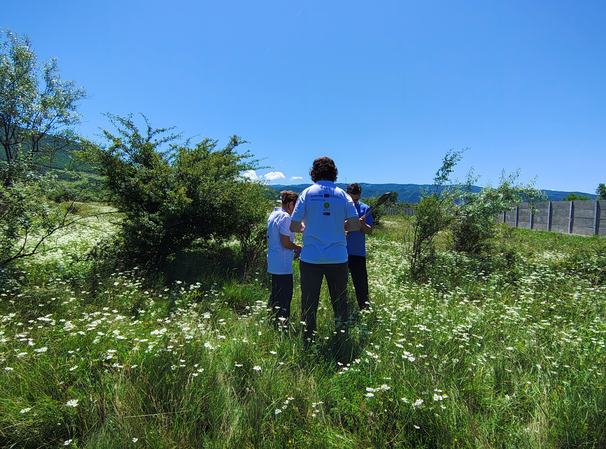
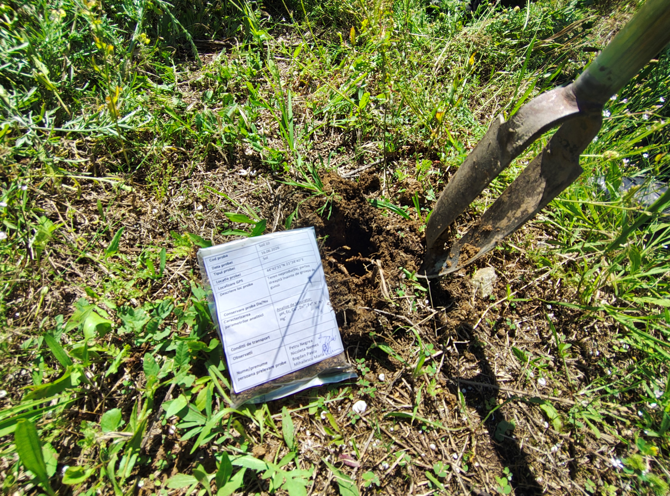
MATERIALS AND METHODS
FIELD WORK
S1
S7
Spring
S10
RORS00063

Slide 5
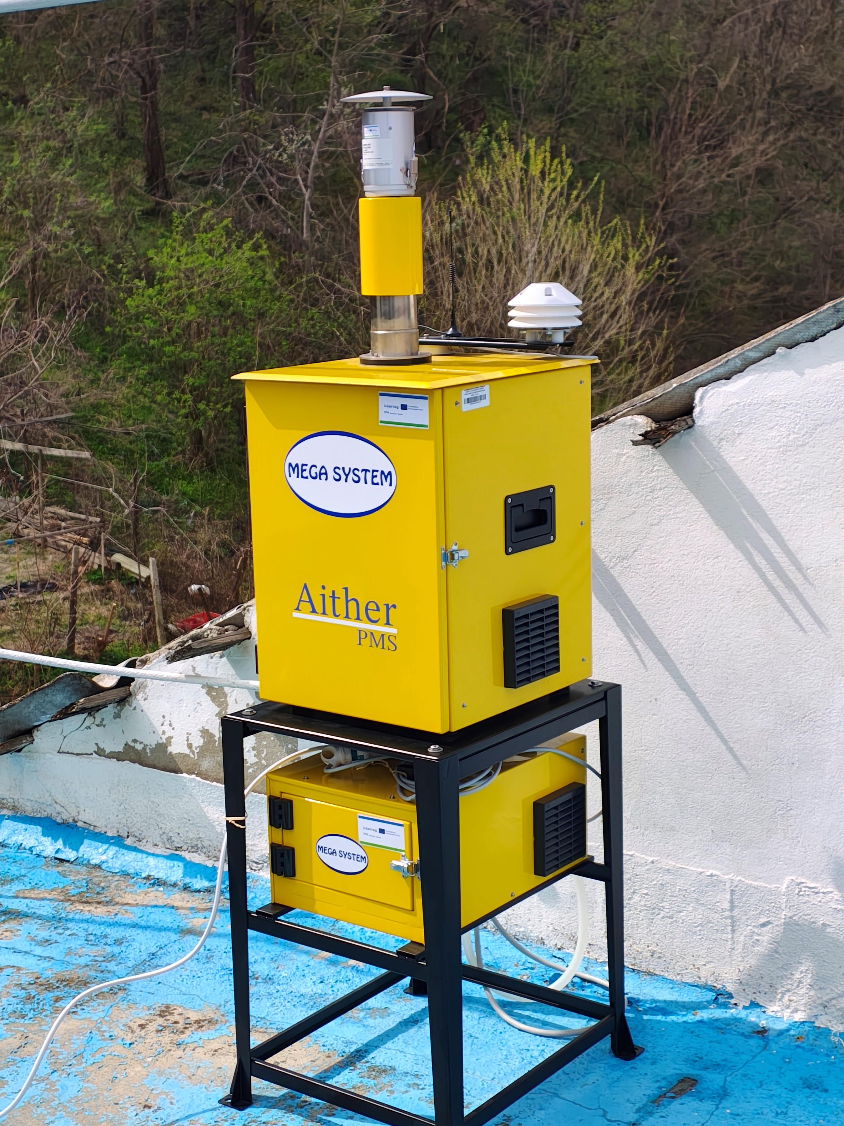
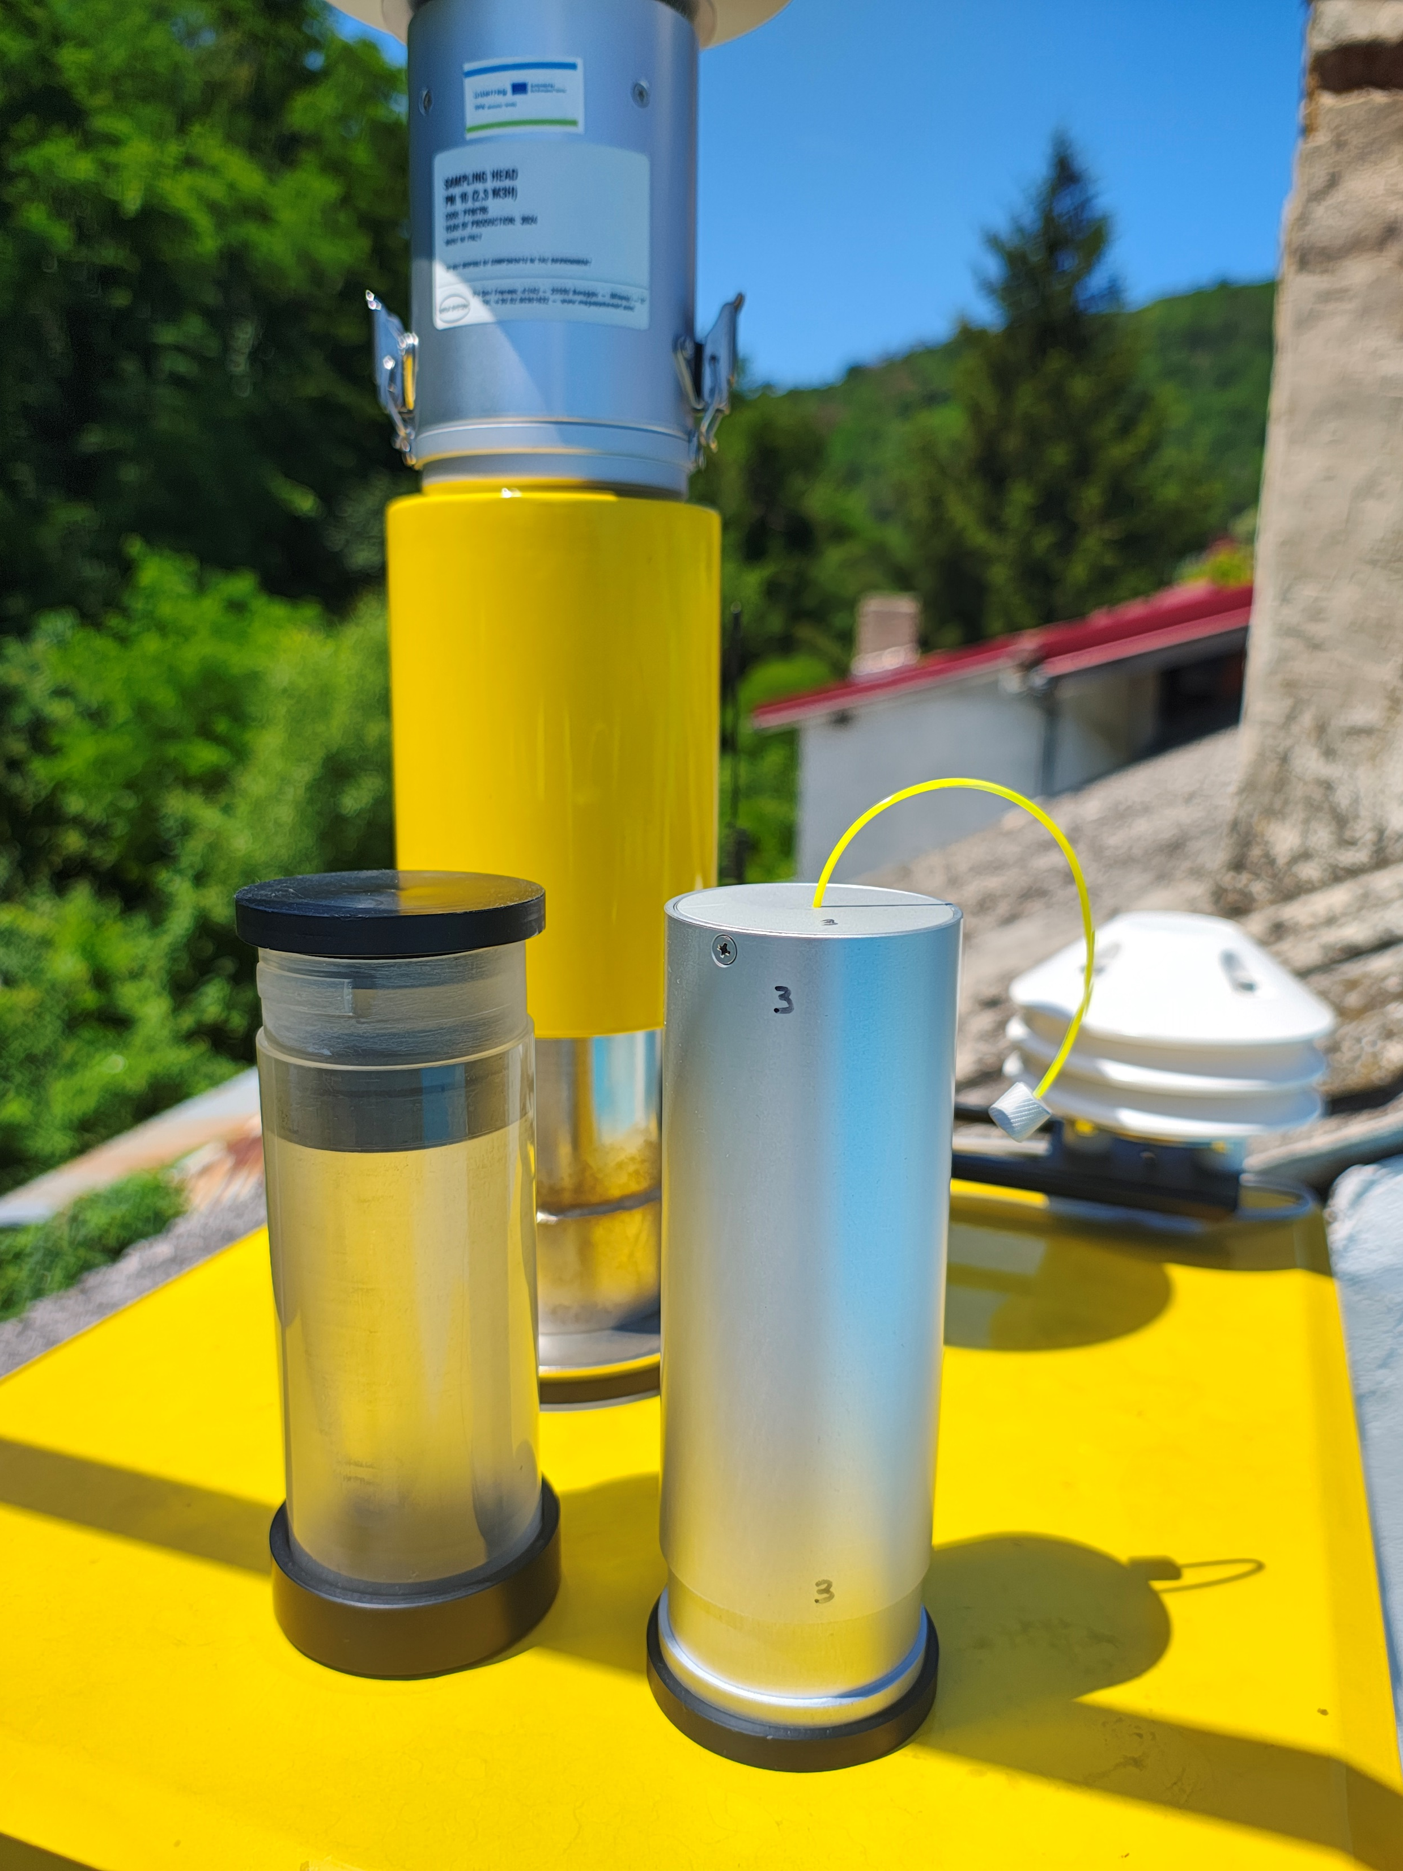
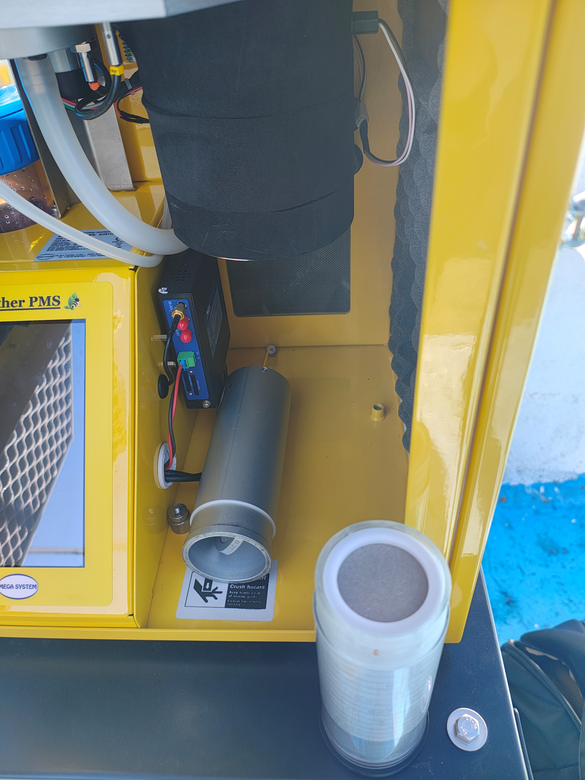
MATERIALS AND METHODS
FIELD WORK
A1
Spring
RORS00063
Notes:
Air samples were collected from the location in Moldova Noua.

Slide 6
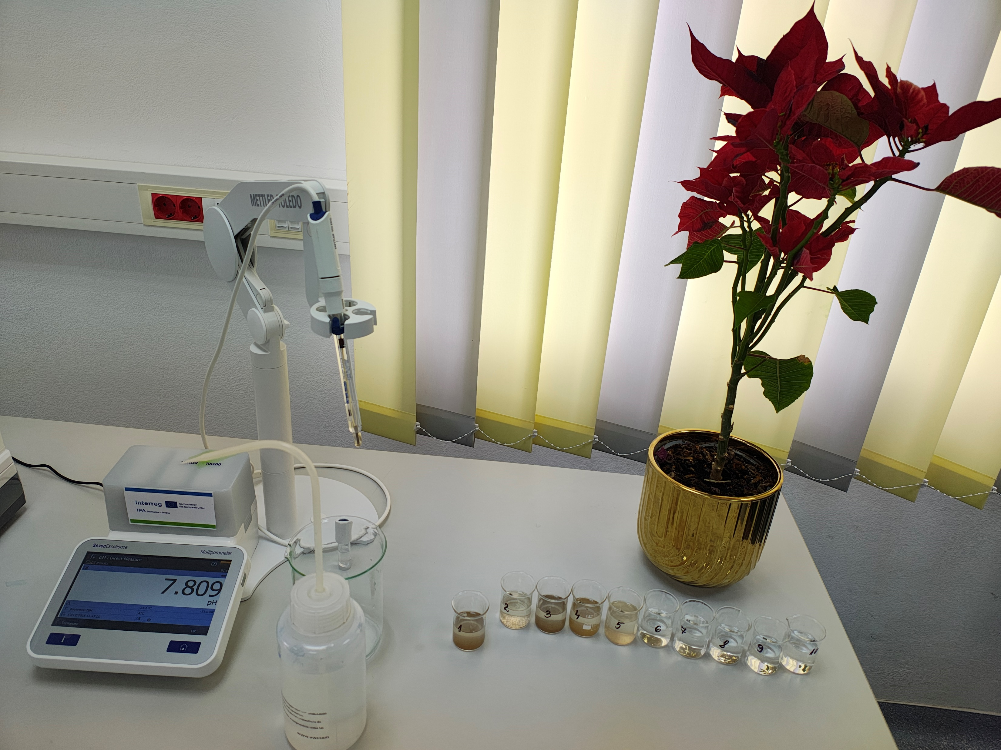
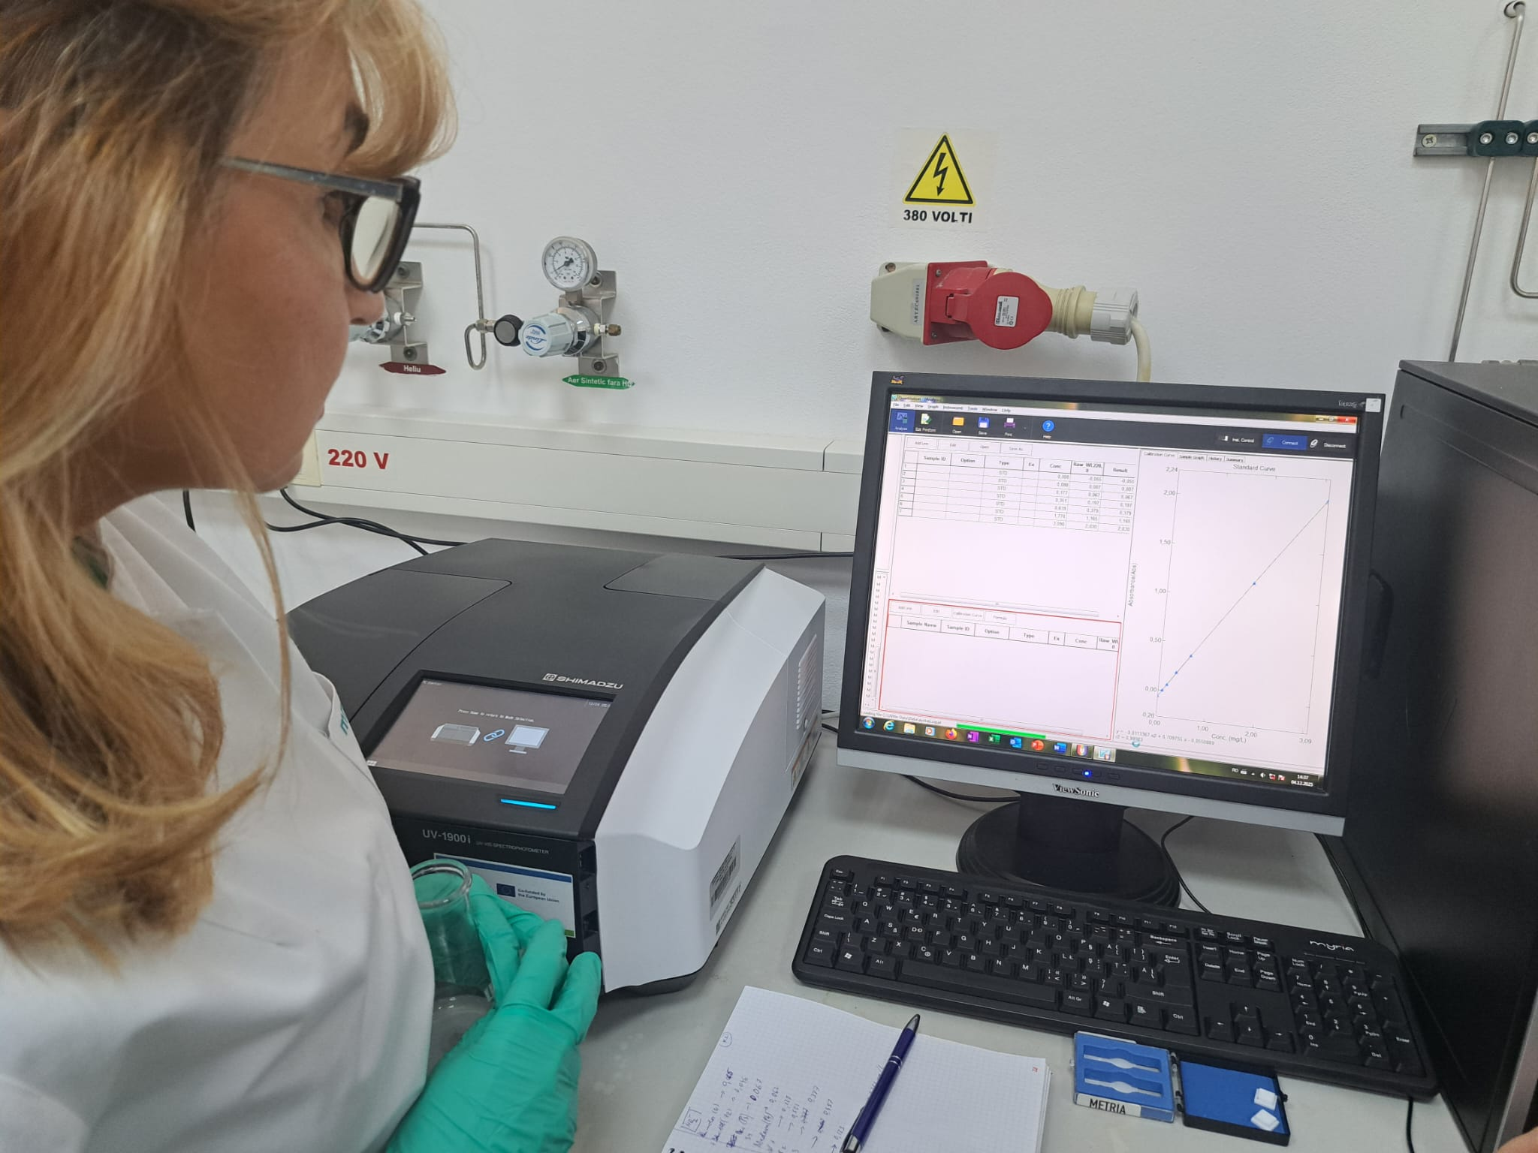
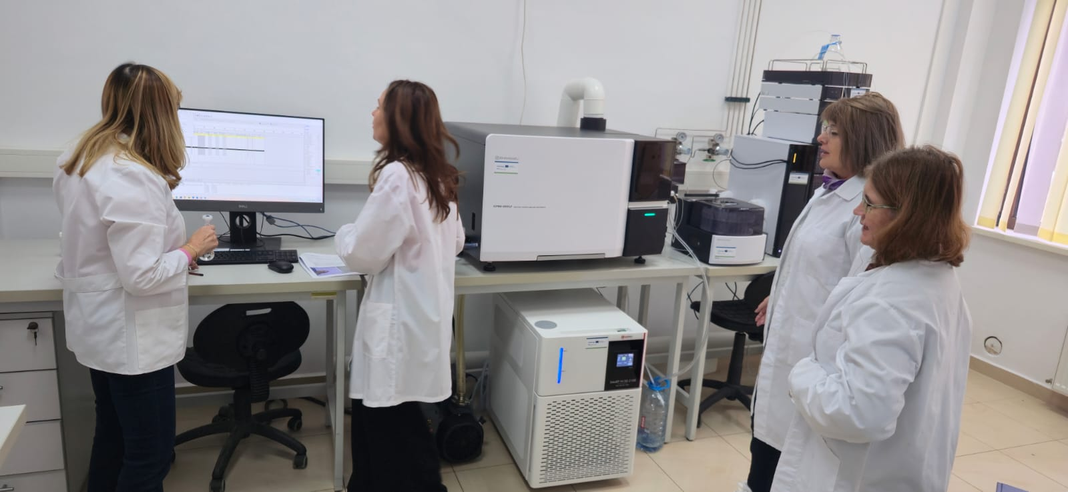
MATERIALS AND METHODS
LABORATORY ANALYSIS
Notes:
The specific analyses were conducted in the laboratories of the Research Institute for Renewable Energies (ICER).

Slide 7
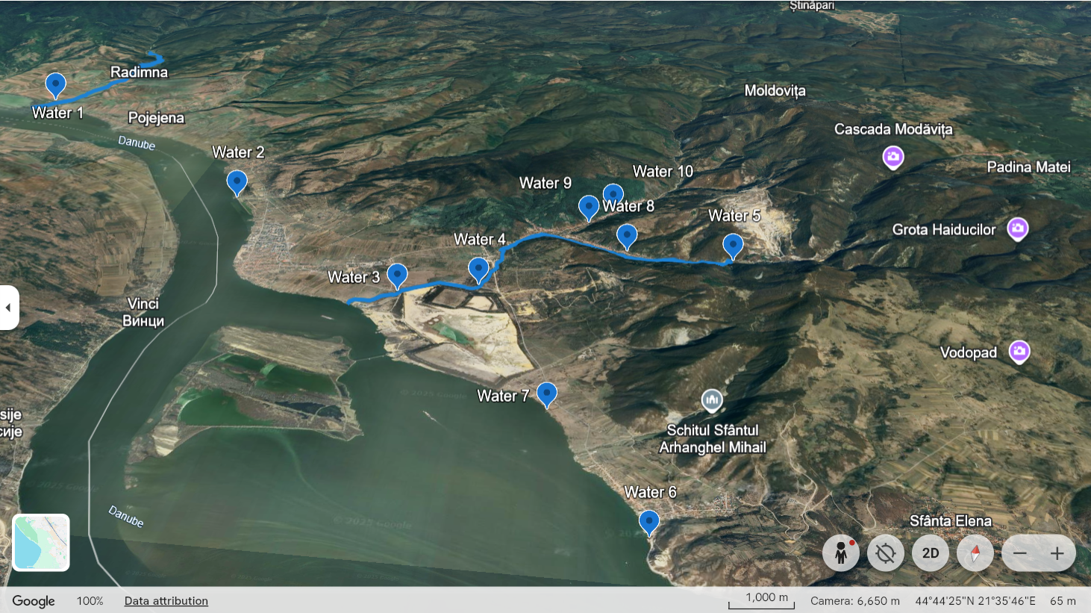
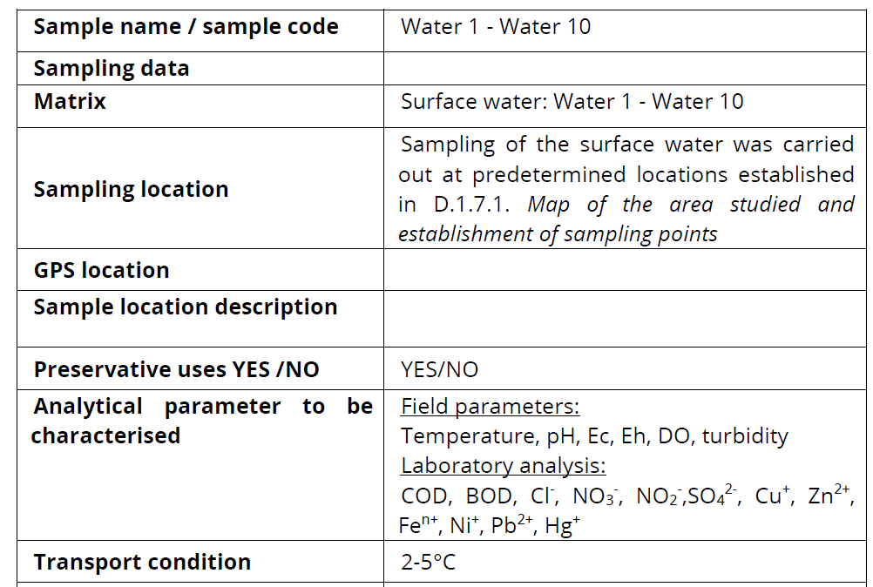
WATER SAMPLES COLLECTION
Table 1. Surface water sampling data
W1, W2 –outside mining zone;
W3, W4 – near tailing ponds;
W5 – near mining career;
W6, W7 – Danube River downstream tailing ponds;
W8, W9, W10 – groundwater;
Map of water sampling locations
RORS00063
Notes:
The locations of the water samples are shown on this map. Thus, W1, W2 –outside mining zone; W3, W4 – near tailing ponds; W5 – near mining career; W6, W7 – Danube River downstream tailing ponds; W8, W9, W10 – groundwater;
Some of the representative parameters are presented in the following slides.

Slide 8
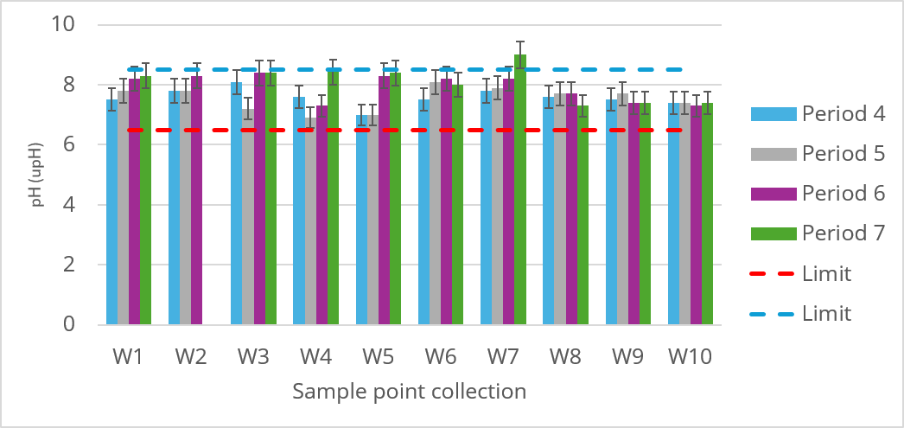
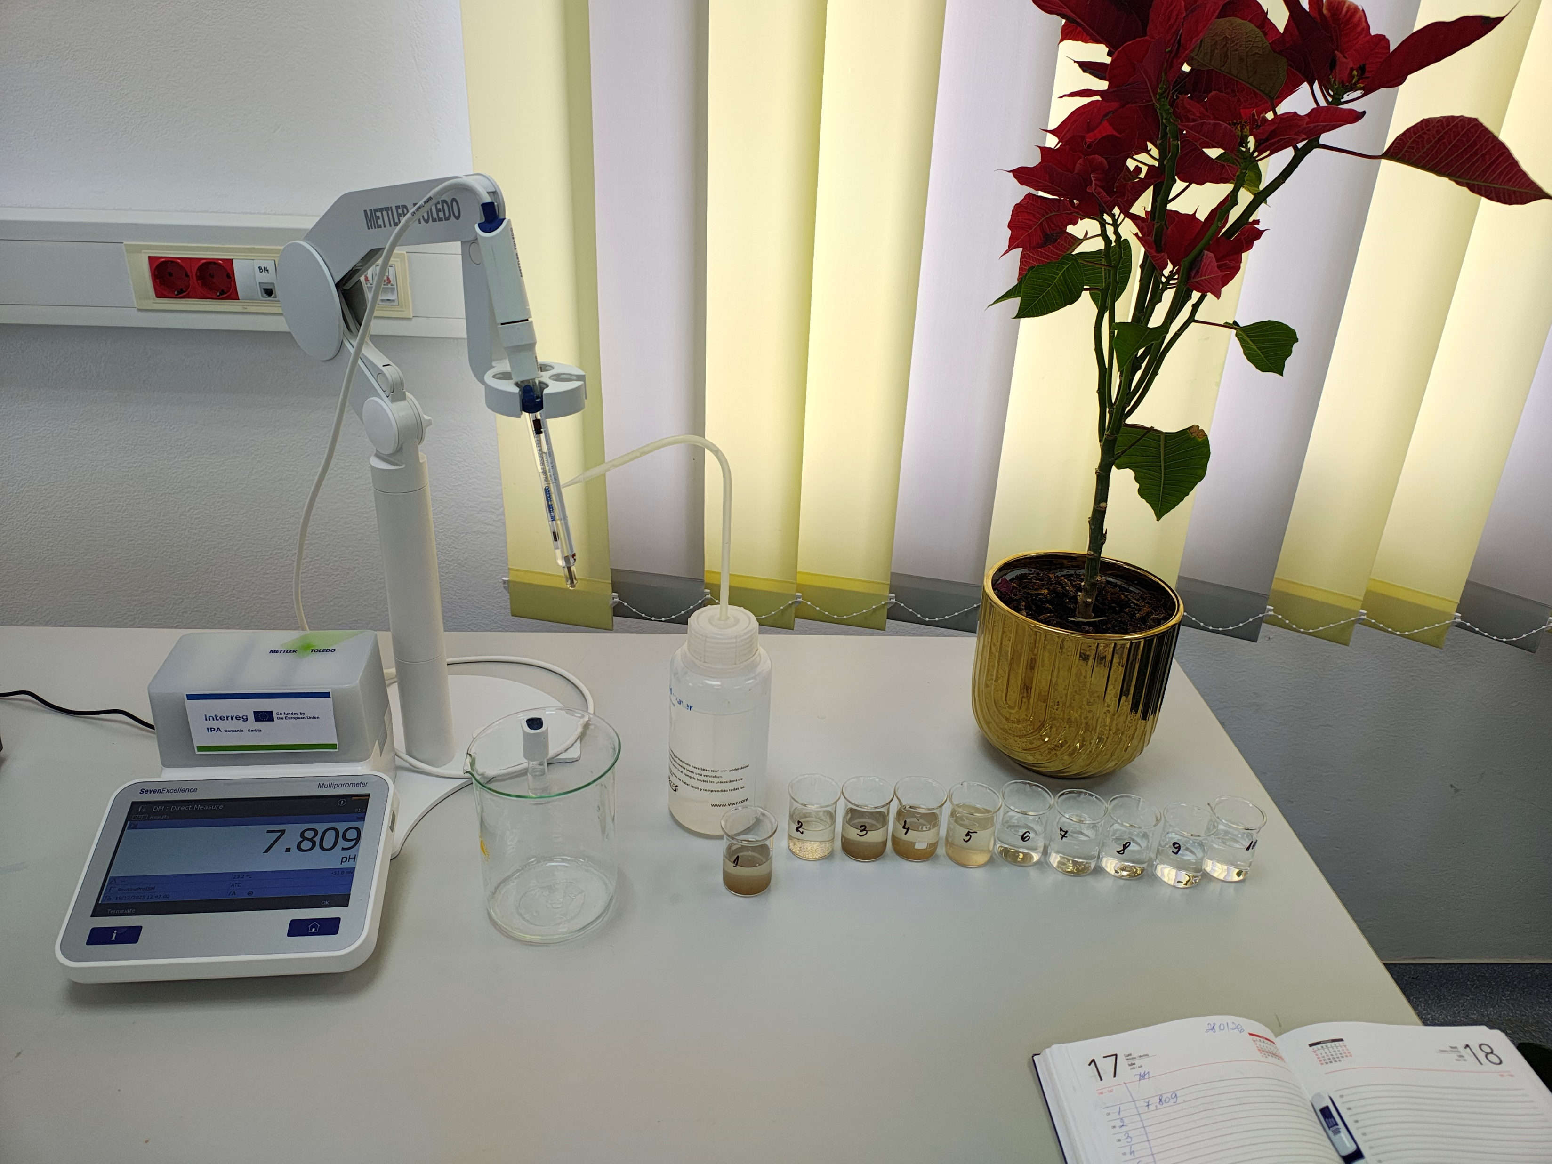
WATER SAMPLES ANALYSIS
pH
RORS00063
Notes:
The pH variation of the water samples falls within the acceptable range of 6.5–8.5. The lowest values were found in sample W5—near the mining site—probable due to dissolved metals present in the form of sulfates or nitrates. However, we cannot rule out acid water runoff generated naturally by the oxidation of sulfur-rich ores as a result of excessive rainfall.

Slide 9
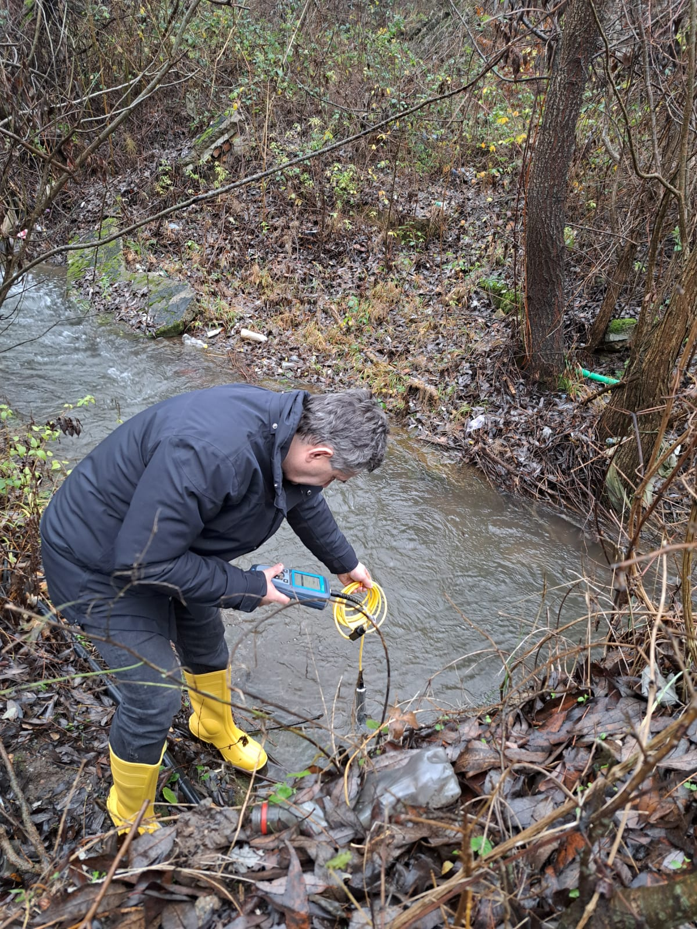
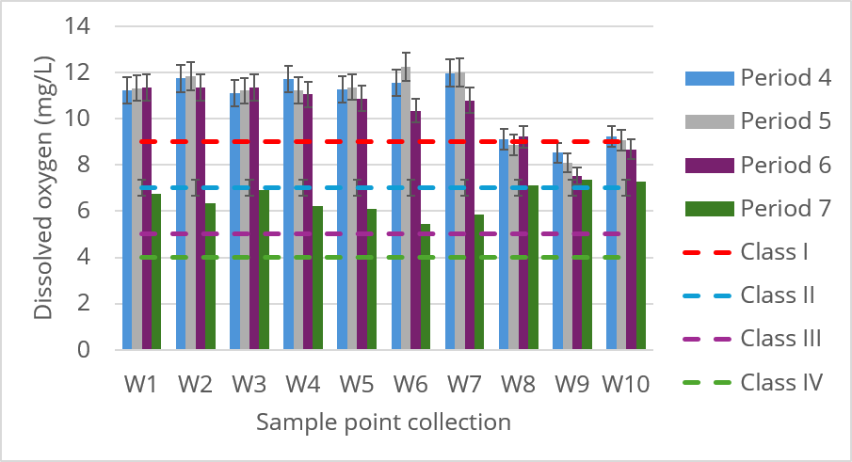
WATER SAMPLES ANALYSIS
Dissolved oxygen
RORS00063
Notes:
The dissolved oxygen levels measured in samples W1–W7 result in the classification of these waters as Class I, excepting the Summer samples (in accordance with the legislation governing the characterization of surface water quality).
For samples W8–W10, which are deep-water samples, the relevant legislation does not specify any permissible limits.

Slide 10
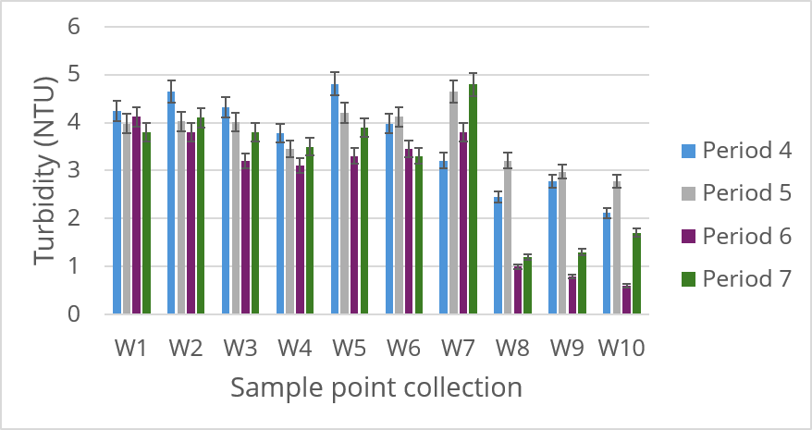
WATER SAMPLES ANALYSIS
Turbidity
directly influences the concentration of mineral pollutants in water, acting as an indicator of the presence of suspended particles, which can adsorb and transport chemicals.
RORS00063
Notes:
Turbidity, another parameter measured, is not regulated by law. Minor variations in this parameter can be observed within the range of 3–5 NTU for surface water.

Slide 11
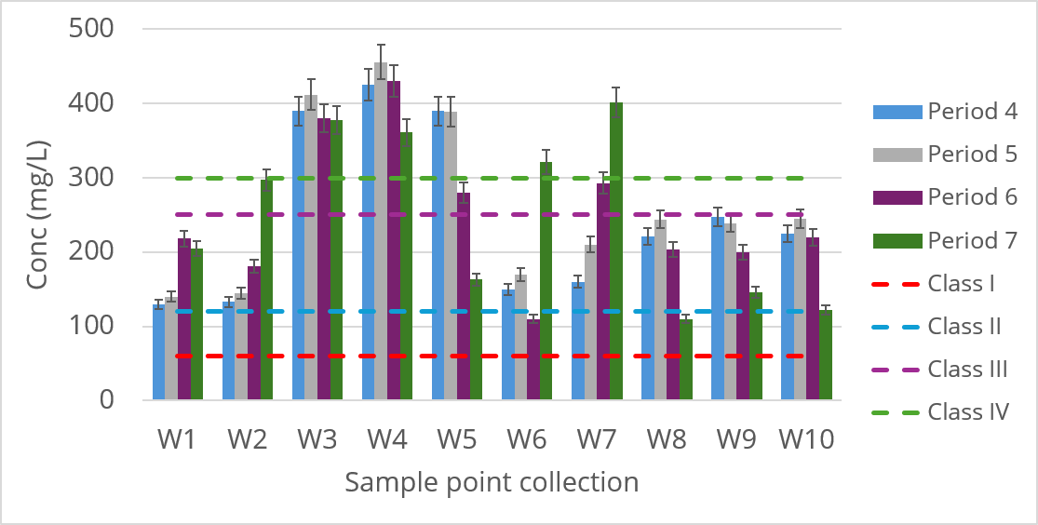
WATER SAMPLES ANALYSIS
Sulfates, SO₄²⁻
High sulfate concentrations are often associated with mining or industrial pollution sources.
RORS00063
Notes:
Another important parameter is the sulfate content.
High values were found in samples W3–W5, which were collected near tailings ponds in the case of W3 and W4 and near a mining quarry in the case of W5.
These waters are classified as Class V, while the rest are classified as Classes I, II, or III.
Possible explanations include the oxidation of metal sulfides. Most mineral deposits contain minerals in the form of sulfides. When these are exposed to air and water as a result of mining activities (excavation, waste dumps, open pits), oxidation reactions occur. The continuous oxidation of sulfides creates a cycle of acidification: The formed acid dissolves even more minerals from the tailings. It releases even more sulfates and heavy metals. It is a self-accelerating process that can last for tens or hundreds of years after the mine is closed. Mine waste rock often contains: gypsum (CaSO₄·2H₂O), as well as sulfate-rich secondary oxidation products. Upon contact with rainwater or groundwater, these minerals dissolve easily.

Slide 12
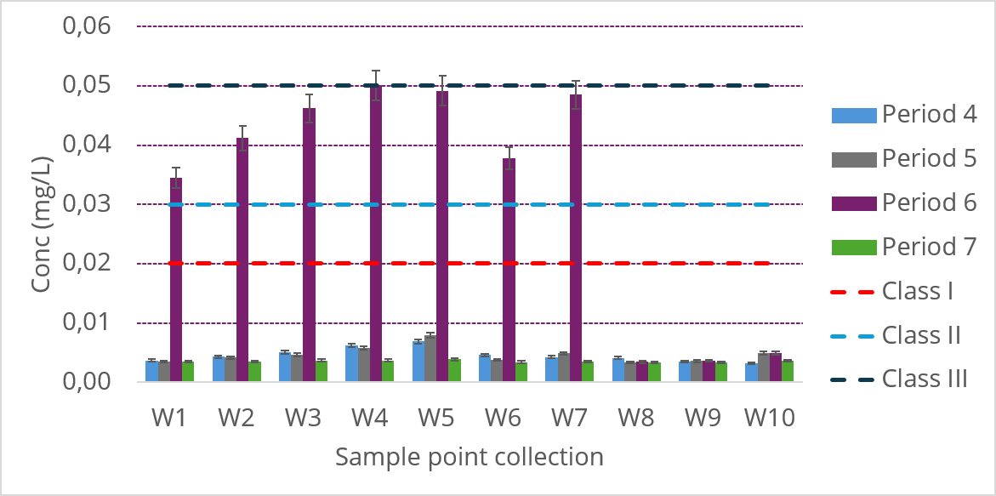
WATER SAMPLES ANALYSIS
Cu (II)
RORS00063
Notes:
It is well known that surface and groundwater can become contaminated following mine closure, at which point tailings piles, quarries, and ponds remain permanent sources of leaching. Rainwater can seep through the waste rock, and metals and sulfates can enter the groundwater.
Critical elements for copper mines: Cu, Fe, Zn, Pb, Cd, Ni.
Below are the concentrations of these metals in the analyzed water samples in the autumn, winter and summer prelevation campagne. In all cases, their concentrations are below the limits set by current legislation.
In the spring campagne the cupper content was significant higher, most likely due to melting snow that brought particles from the rocks.

Slide 13
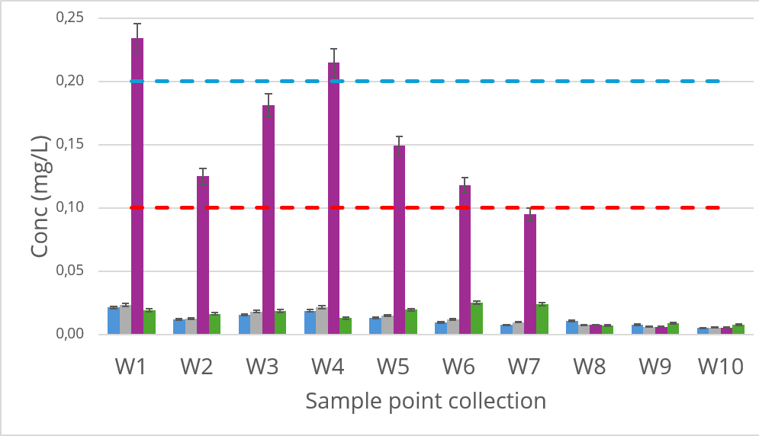
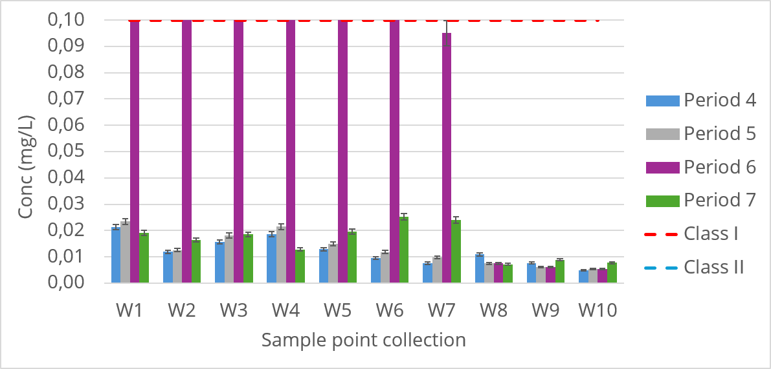
WATER SAMPLES ANALYSIS
Zn (II)
RORS00063
Notes:
Zinc concentrations are higher, especially in the sample W4 (near the tailings ponds), and W5 (near the quarry). Possible explanations include:
Transport via groundwater (leaching), and zinc has high solubility in the presence of sulfates, acidic water, or CO₂-rich water.

Slide 14
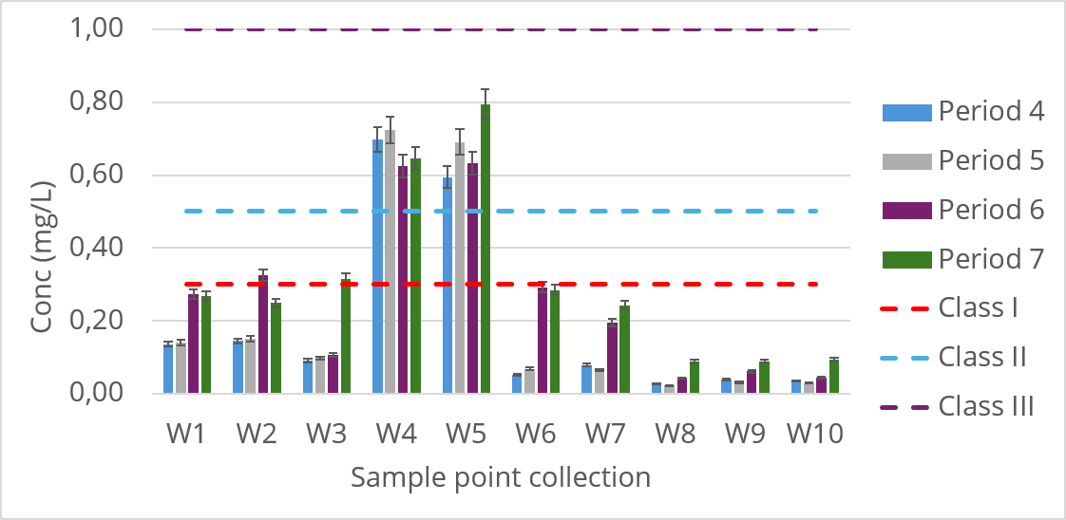
WATER SAMPLES ANALYSIS
Fe _{total}
RORS00063
Notes:
Iron content is high in samples W4 and W5.
W4 was taken near the tailings ponds and W5 near the mining site. Values which are to be expected given pyrite (CuFeS₂) being the most commonly encountered copper ore.

Slide 15
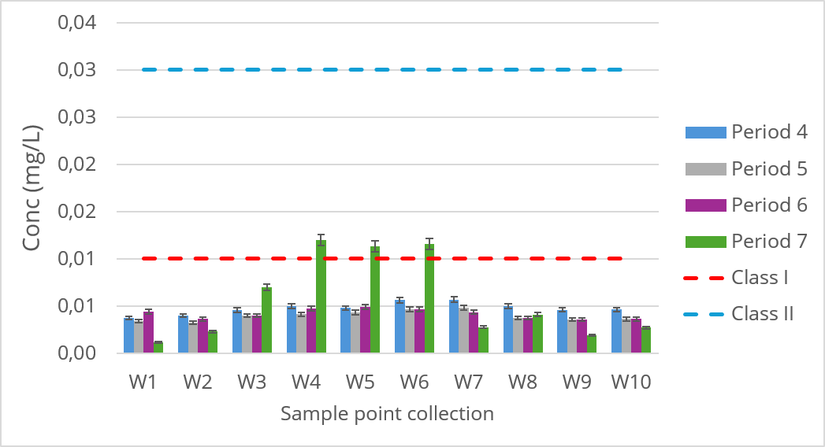
WATER SAMPLES ANALYSIS
Ni (II)
RORS00063
Notes:
Elevated nickel levels were observed in all collected water samples, but they remained within the limits permitted by current legislation. The presence of this metal is due to the fact that it is found alongside the other metals present.

Slide 16
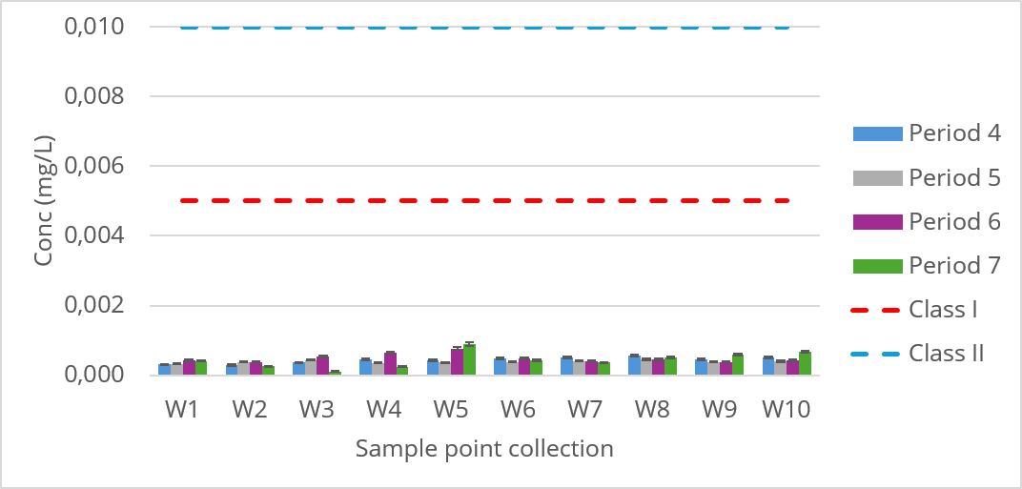
WATER SAMPLES ANALYSIS
Pb (II)
RORS00063
Notes:
A similar pattern is observed for lead content. Along with the other elements, it can be found in the areas indicated. The lead content is much lower than the legal limit for class I of fresh waters.

Slide 17
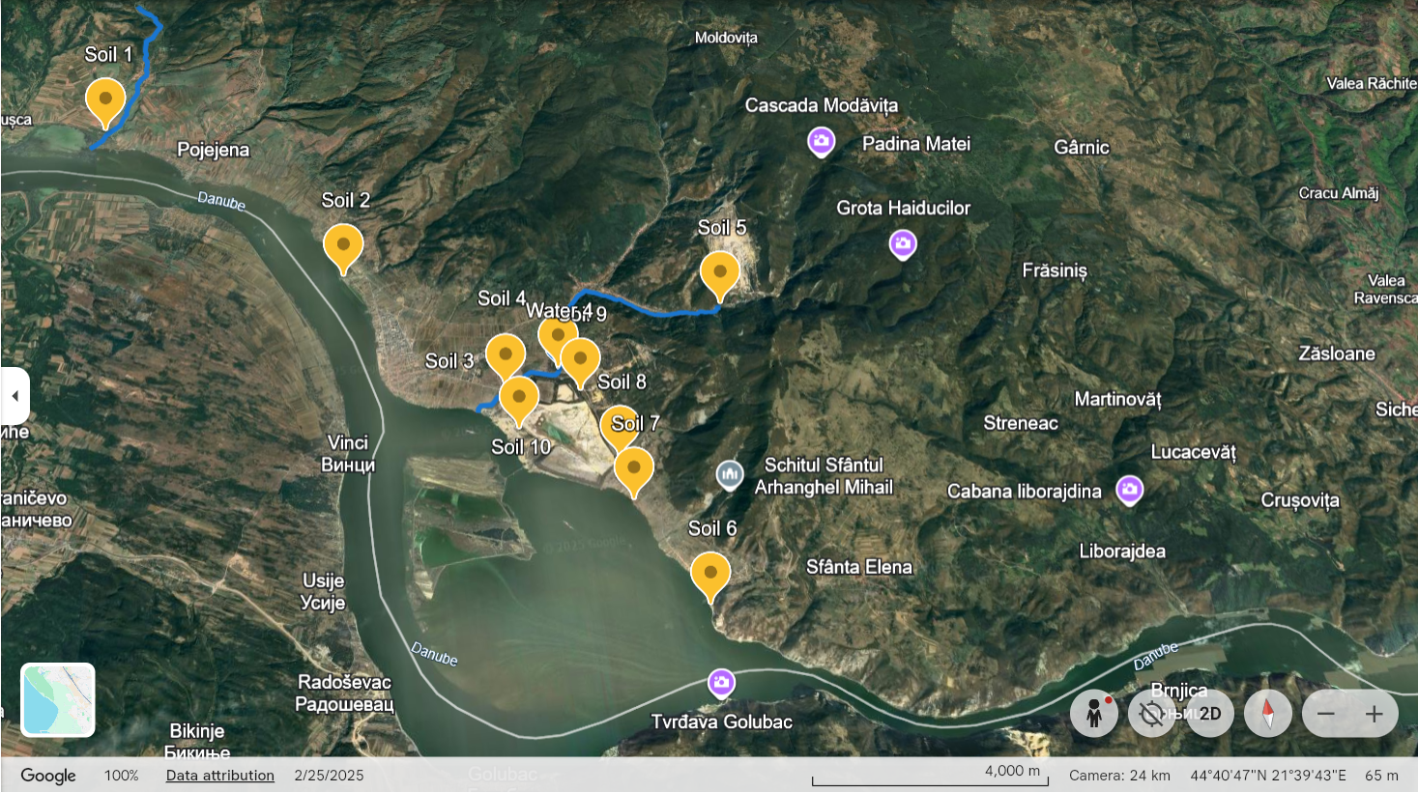
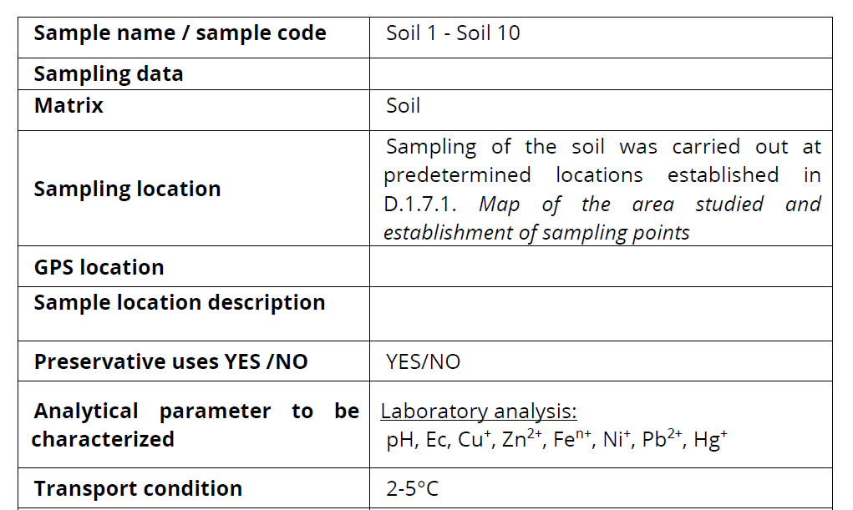
SOIL SAMPLES COLLECTION
Table 2. Soil sampling data
S1, S2 –outside mining zone;
S3, S4 – near tailing ponds;
S5 – near mining career;
S6, S7 – Danube bed River downstream tailing ponds;
S8, S9, S10 – around tailing ponds
Map of soil sampling locations
RORS00063
Notes:
Another environmental factor of interest regarding the potential environmental issues in this area is the soil. The samples collected outside the mining zone are Soil 1 and Soil 2; near tailing ponds Soil 3 and Soil 4, near the mining site Soil 5; Danube bed River downstream tailing ponds in case of Soil 6, Soil 7 and around tailing ponds (S8, S9, S10).
Soils in the vicinity of mining operations are affected by various physical, chemical, and biological processes. Pollution is not just a local issue—it can spread over long distances, including into agricultural or residential areas. Mining operations, particularly those for copper, zinc, lead, or nickel, leave behind rock and tailings rich in: Cu(II); Zn(II); Pb(II); Ni(II); Fe, etc. These metals end up in the soil through:
- deposition of wind-blown metal dust, leaching from waste dumps and ponds, acid water runoff, etc.

Slide 18
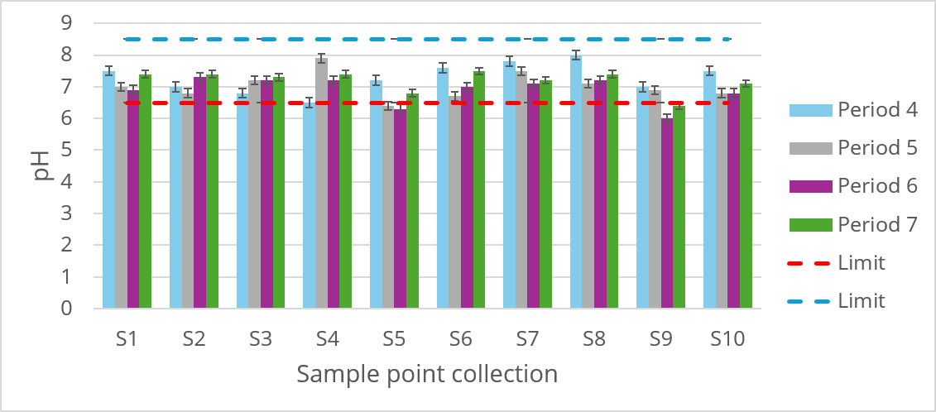
SOIL SAMPLES ANALYSIS
pH
RORS00063
Notes:
pH, is an important parameter for characterizing soils.
The oxidation of sulfides (pyrite, chalcopyrite, pyrrhotite) produces sulfuric acid. It lowers the soil’s pH, increases the solubility of heavy metals, inhibits plant growth, and affects soil microorganisms.
Acidic soils are much more prone to leaching toxic metals.
Stable and optimal zones (S1, S2, S3, S7): These points maintain a constant neutral or slightly acidic pH (between 6.8 and 7.8) in all four periods.
Critical zone S5 (Constant acidification): The pH has dropped below the limit of 6.5 since Period 5 and has remained there in periods 6 and 7. The soil at this point is becoming increasingly acidic.
Critical zone S9 (near dump): In Period 6, this point records the lowest value in the entire graph (pH around 6.0). Although in Period 7 it increased slightly, it still remains below the ideal limit of 6.5.

Slide 19
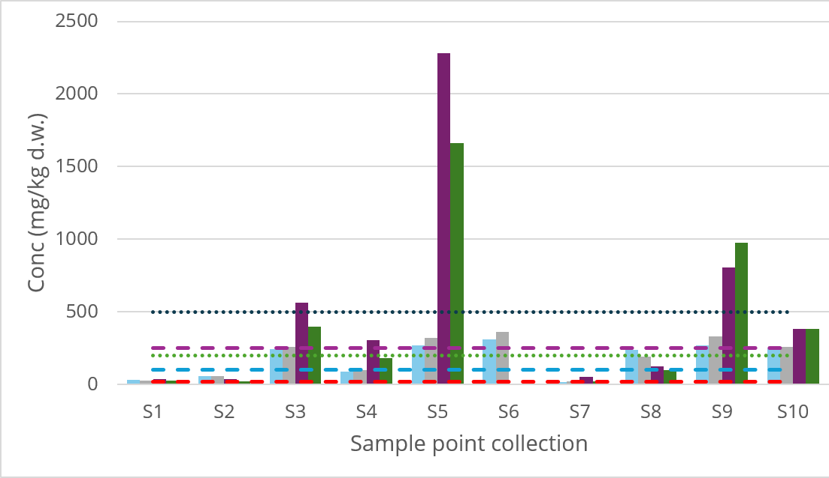
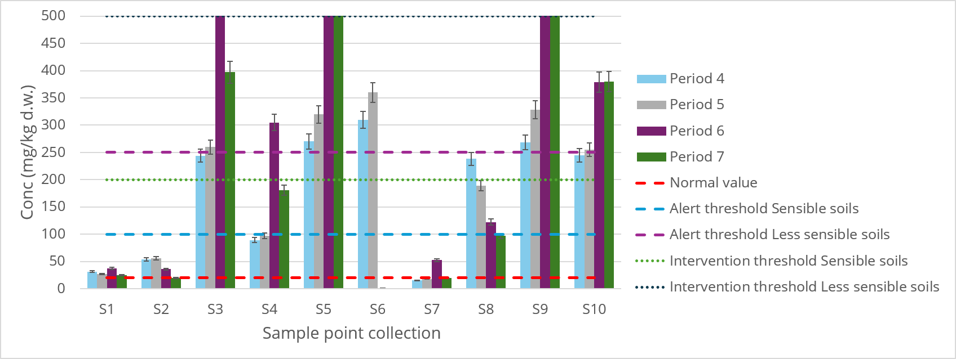
SOIL SAMPLES ANALYSIS
Cu (II)
RORS00063
Notes:
Elevated copper levels in zones S5, S6, and S9 classify the soils as falling within the Intervention Threshold zone, while the rest fall within the Alert Threshold zone. Copper levels in the soils of the Moldova Nouă area frequently show high values due to a combination of local geology, mining activities, and physicochemical processes triggered by resource extraction.

Slide 20
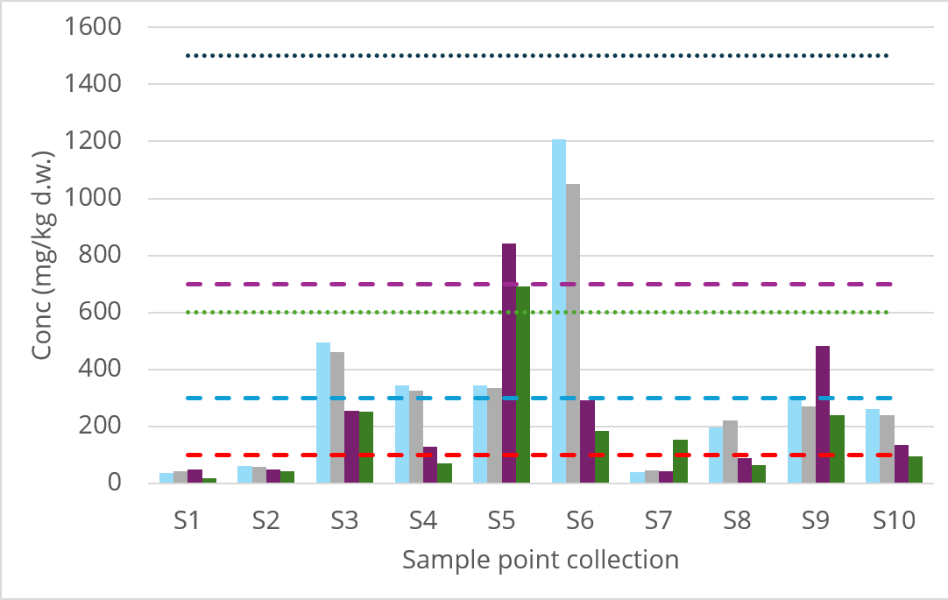
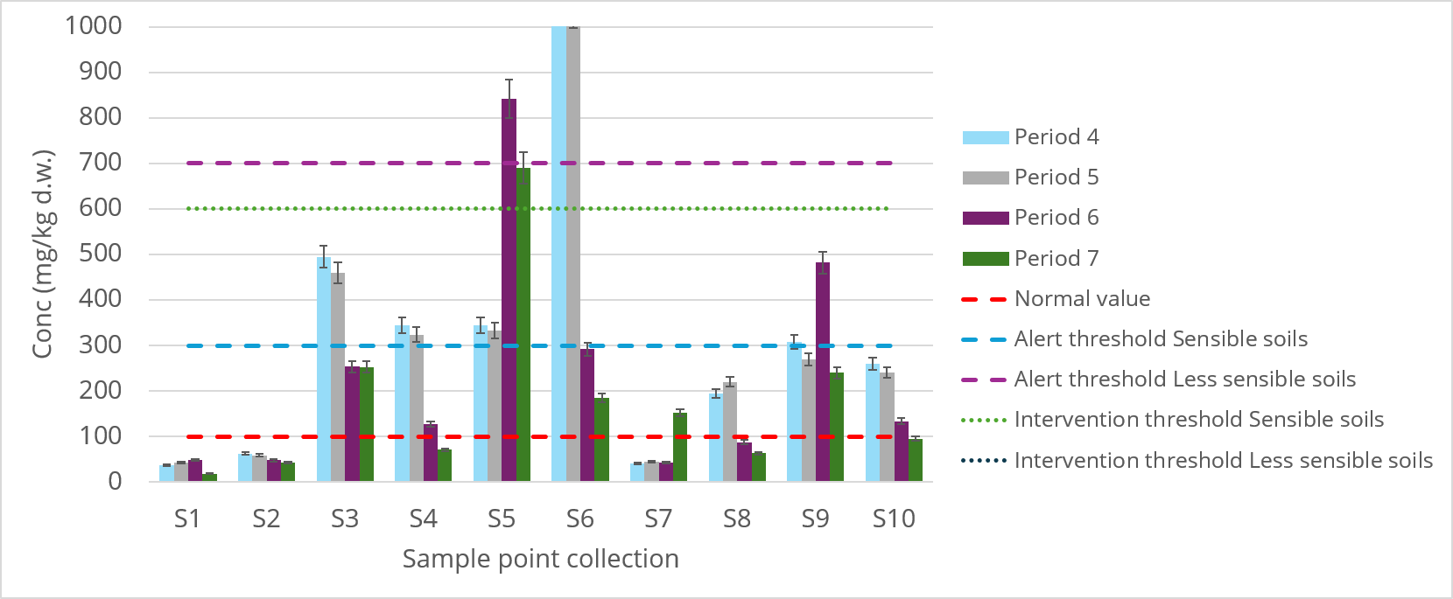
SOIL SAMPLES ANALYSIS
Zn (II)
RORS00063
Notes:
The relatively high zinc content, particularly in sample S6, places that area within the Intervention threshold range, while the remaining samples fall within normal limits or, at most, within the Alert threshold limits.

Slide 21
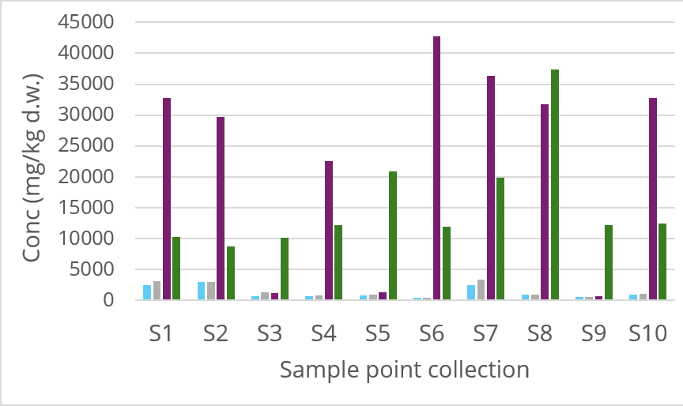
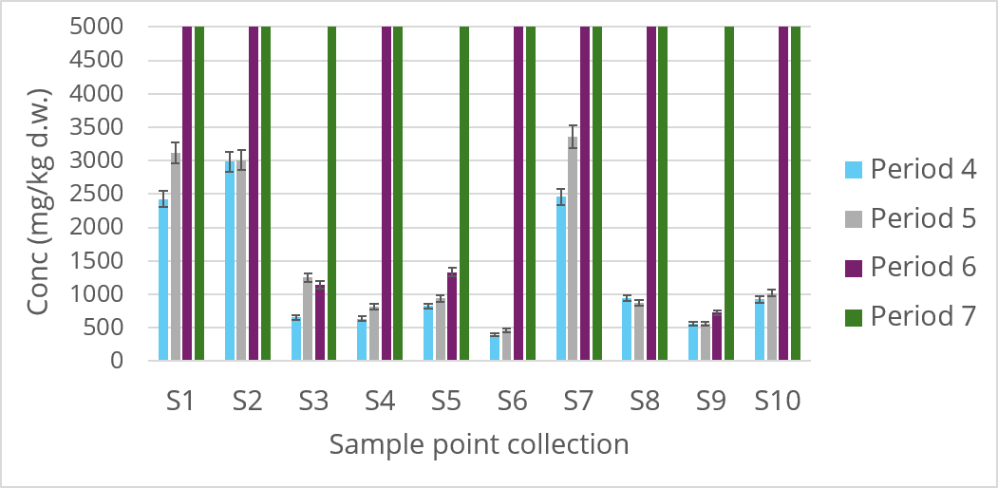
SOIL SAMPLES ANALYSIS
Fe^{n+}
a high value of iron ions (in the form of oxides) under aerobic conditions helps to decrease the concentration of active mineral pollutants, while reducing conditions (acidity, excessive humidity) can lead to their release into the environment.
RORS00063
Notes:
There are no legal limits on the iron content in soil, as iron is a ubiquitous metal.

Slide 22
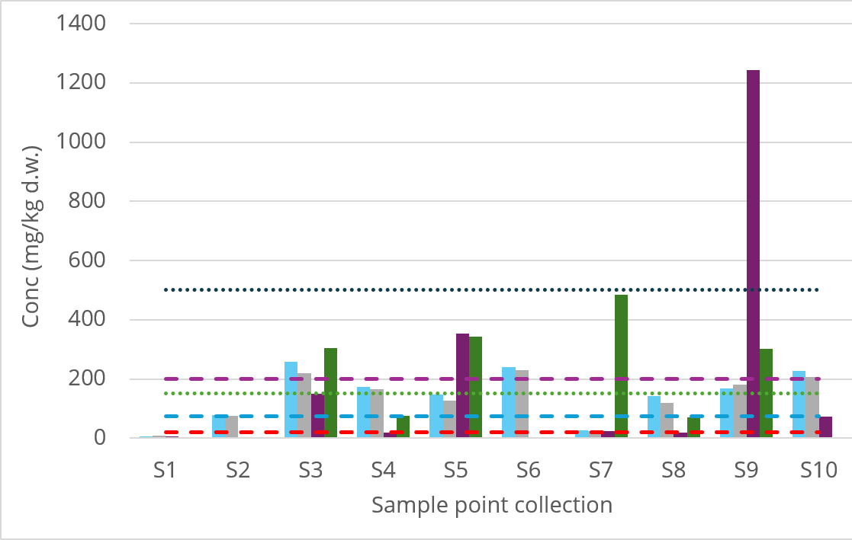
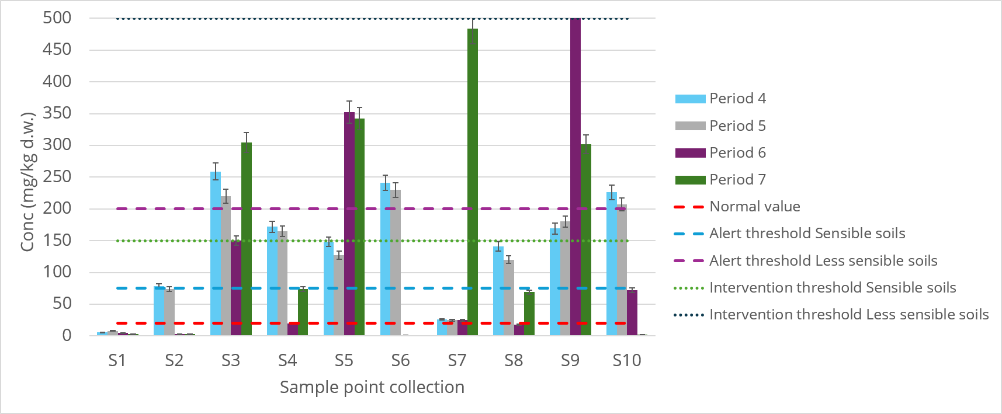
SOIL SAMPLES ANALYSIS
Ni (II)
RORS00063
Notes:
In contrast, the nickel content is elevated in most samples, with the samples falling within the alert threshold range.

Slide 23
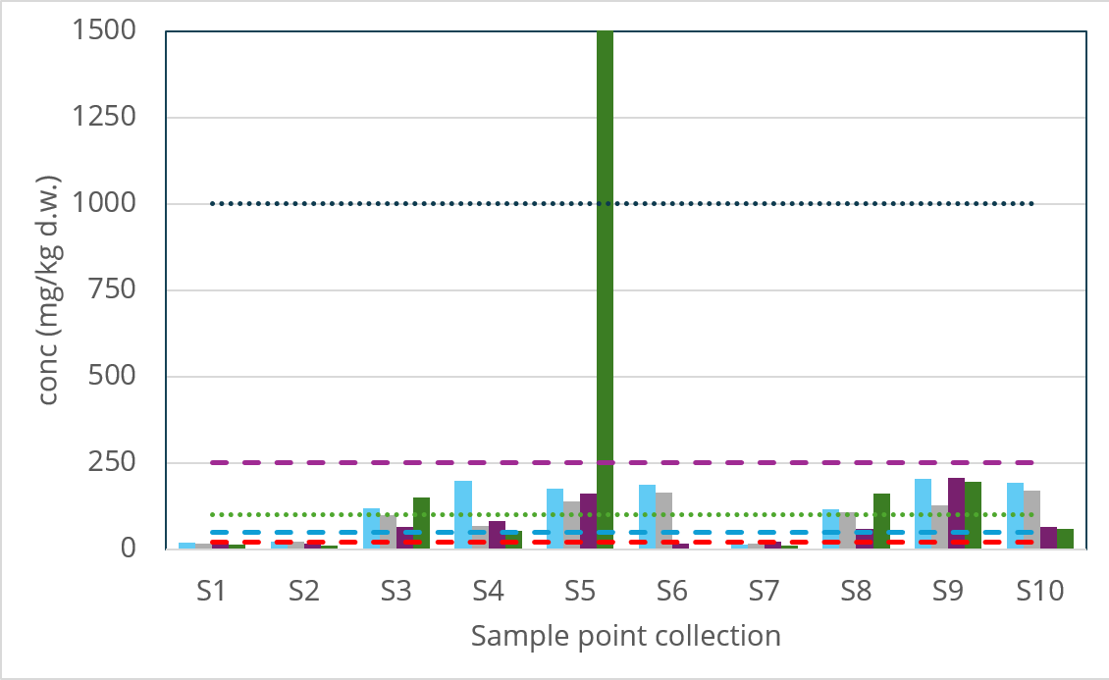
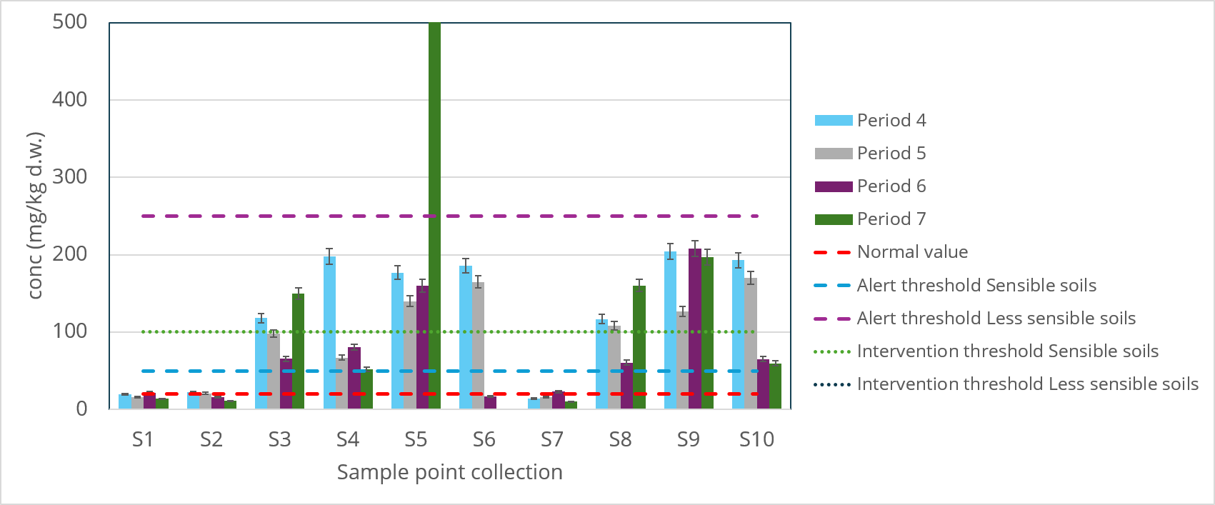
SOIL SAMPLES ANALYSIS
Pb (II)
RORS00063
Notes:
In mining areas, soils form over rocks containing sulfide minerals and metal oxides, , thus Pb content is in the alert threshold.
Plumbul (Pb) most often comes from galena (PbS).
Ai 2 reprezentari. Cea logaritmica este pentru a se observa mai usor incadrarea in limitele de alerta si de interventie.

Slide 24
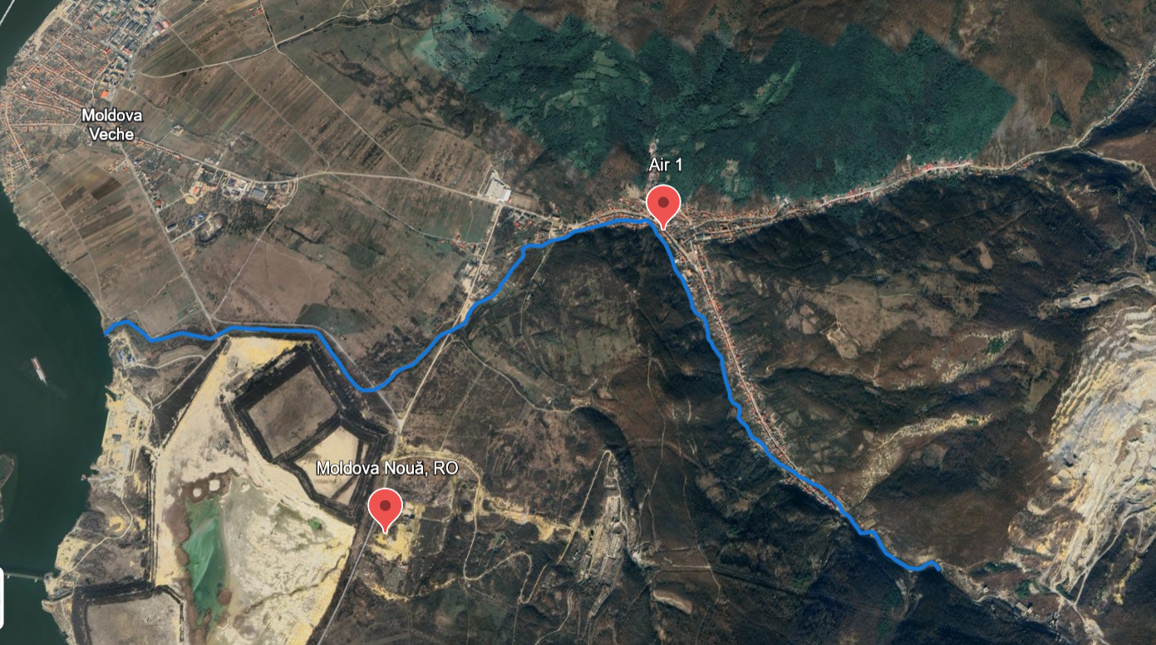
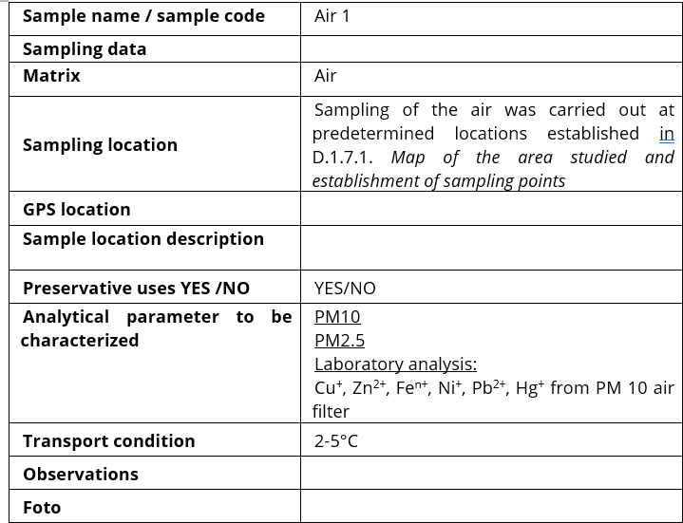
AIR SAMPLES COLECTION
Table 3. Air sampling data
Map of air sampling location
RORS00063

Slide 25
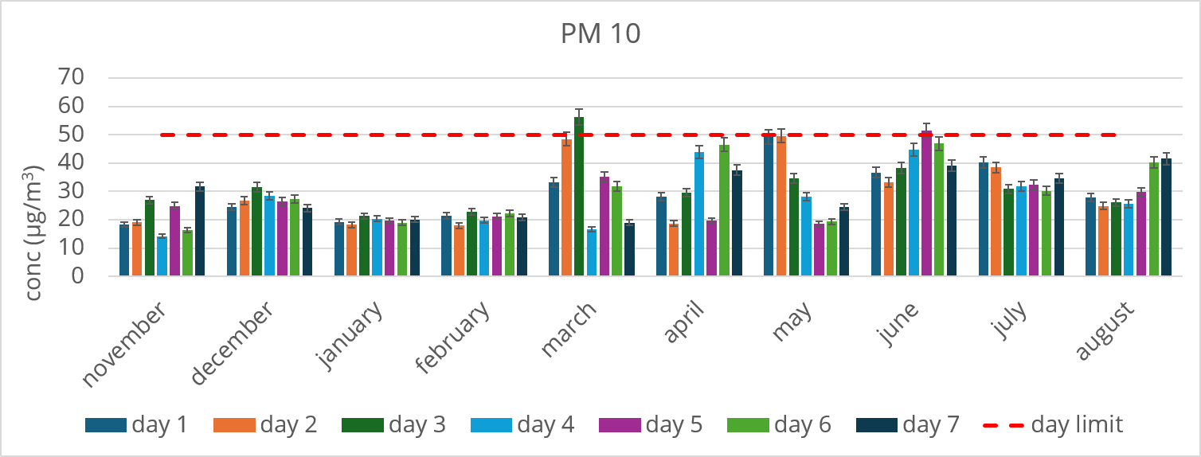
AIR SAMPLES ANALYSIS
PM 10
RORS00063

Slide 26
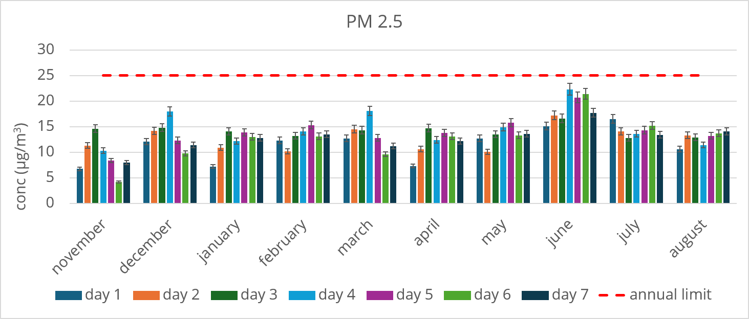
AIR SAMPLES ANALYSIS
PM 2.5
RORS00063

Slide 27
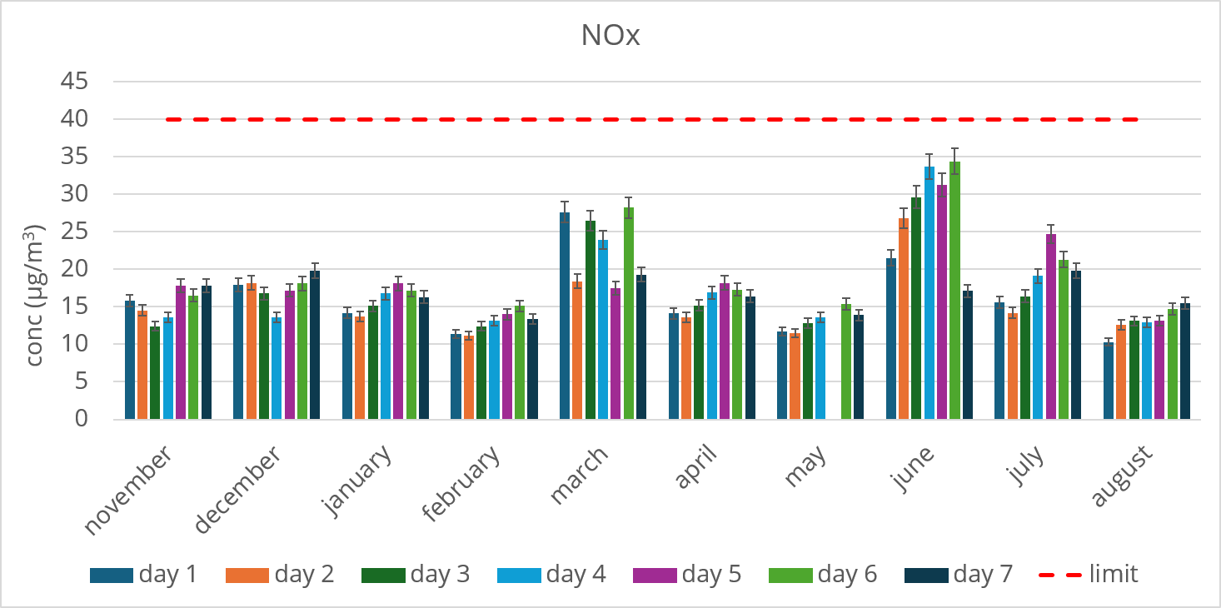
AIR SAMPLES ANALYSIS
NOx
RORS00063

Slide 28
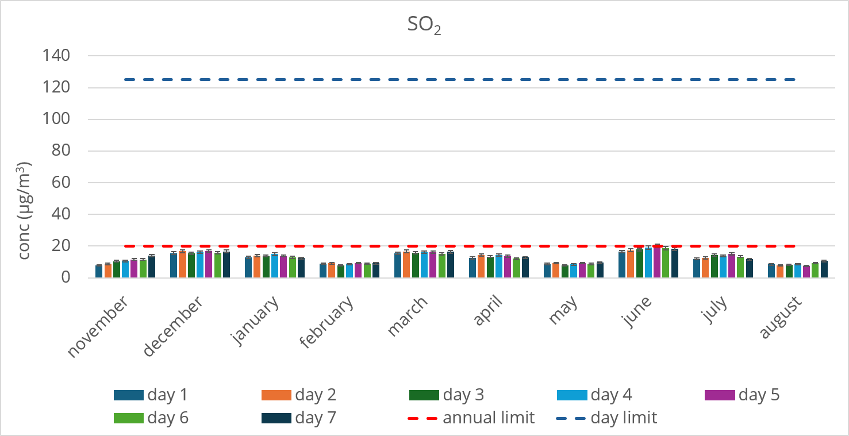
AIR SAMPLES ANALYSIS
SO₂
RORS00063

Slide 29
ENVIRONMENTAL CHARACTERIZATION
Mining sites pose a risk of water contamination through contact with surface water or groundwater.
High concentrations of sulfates, iron, copper, nickel, and zinc indicate the influence of sulfide oxidation processes and acid mine drainage (AMD). Sampling points located near the quarry and ponds (W3–W5) show the highest concentrations, confirming the role of the mining area as the primary source of contamination. Concentrations decrease with distance from the source, but some elements (e.g., sulfates and Zn) remain detectable downstream, a sign of high mobility.
Soils near the tailing piles exhibit elevated levels of Cu, Pb, Ni, and Zn, due to wind-borne deposition, leaching, and the mineralized geological substrate. Copper and lead accumulate predominantly in the surface layer, indicating historical contamination and long-term persistence. Nickel exhibits moderate mobility and can migrate to greater depths under low pH condition. More distant areas have lower concentrations but remain influenced by the transport of fine particles originating from the tailing ponds and the quarry.
Sterile piles are unstable and have an impact on the landscape (being visible from a distance), topography, and hydrology;
The sterile alters the condition of existing ecosystems, leading to the emergence new ecosystems nearby it, weakly developed.
RORS00063

Slide 30
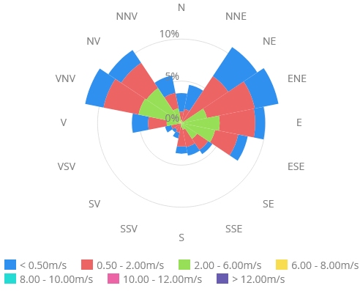
ENVIRONMENTAL CHARACTERIZATION
The air quality factor is generally good with minor, short-term exceptions.
PM10 exceeded the daily limit.
PM2.5 and NOx stayed completely below their respective limits.
_{Wind rose Moldova Nouă, 2026}
PM10 concentrations are strongly influenced by wind direction: winds from the west (V) and northwest (NV) often bring cleaner air, while stagnant air masses or those from the east/southeast (E/SE) can favor the accumulation of local pollutants from road traffic or industrial activities in the area.
Influence of wind direction on PM10
Winds from the West/Northwest (W/NW-dominant sector from the Danube area): contribute to the rapid dispersion of PM10 particles, maintaining air quality within normal or good limits.
Winds from the East/Southeast (E/SE) or Atmospheric Calm: Reduce dispersion, causing a temporary increase in the concentration of suspended dust in the low-lying areas of the area.
A higher wind speed effectively cleans the atmosphere, decreasing PM10 values, while periods without wind block pollutants on the ground.
RORS00063

Slide 31
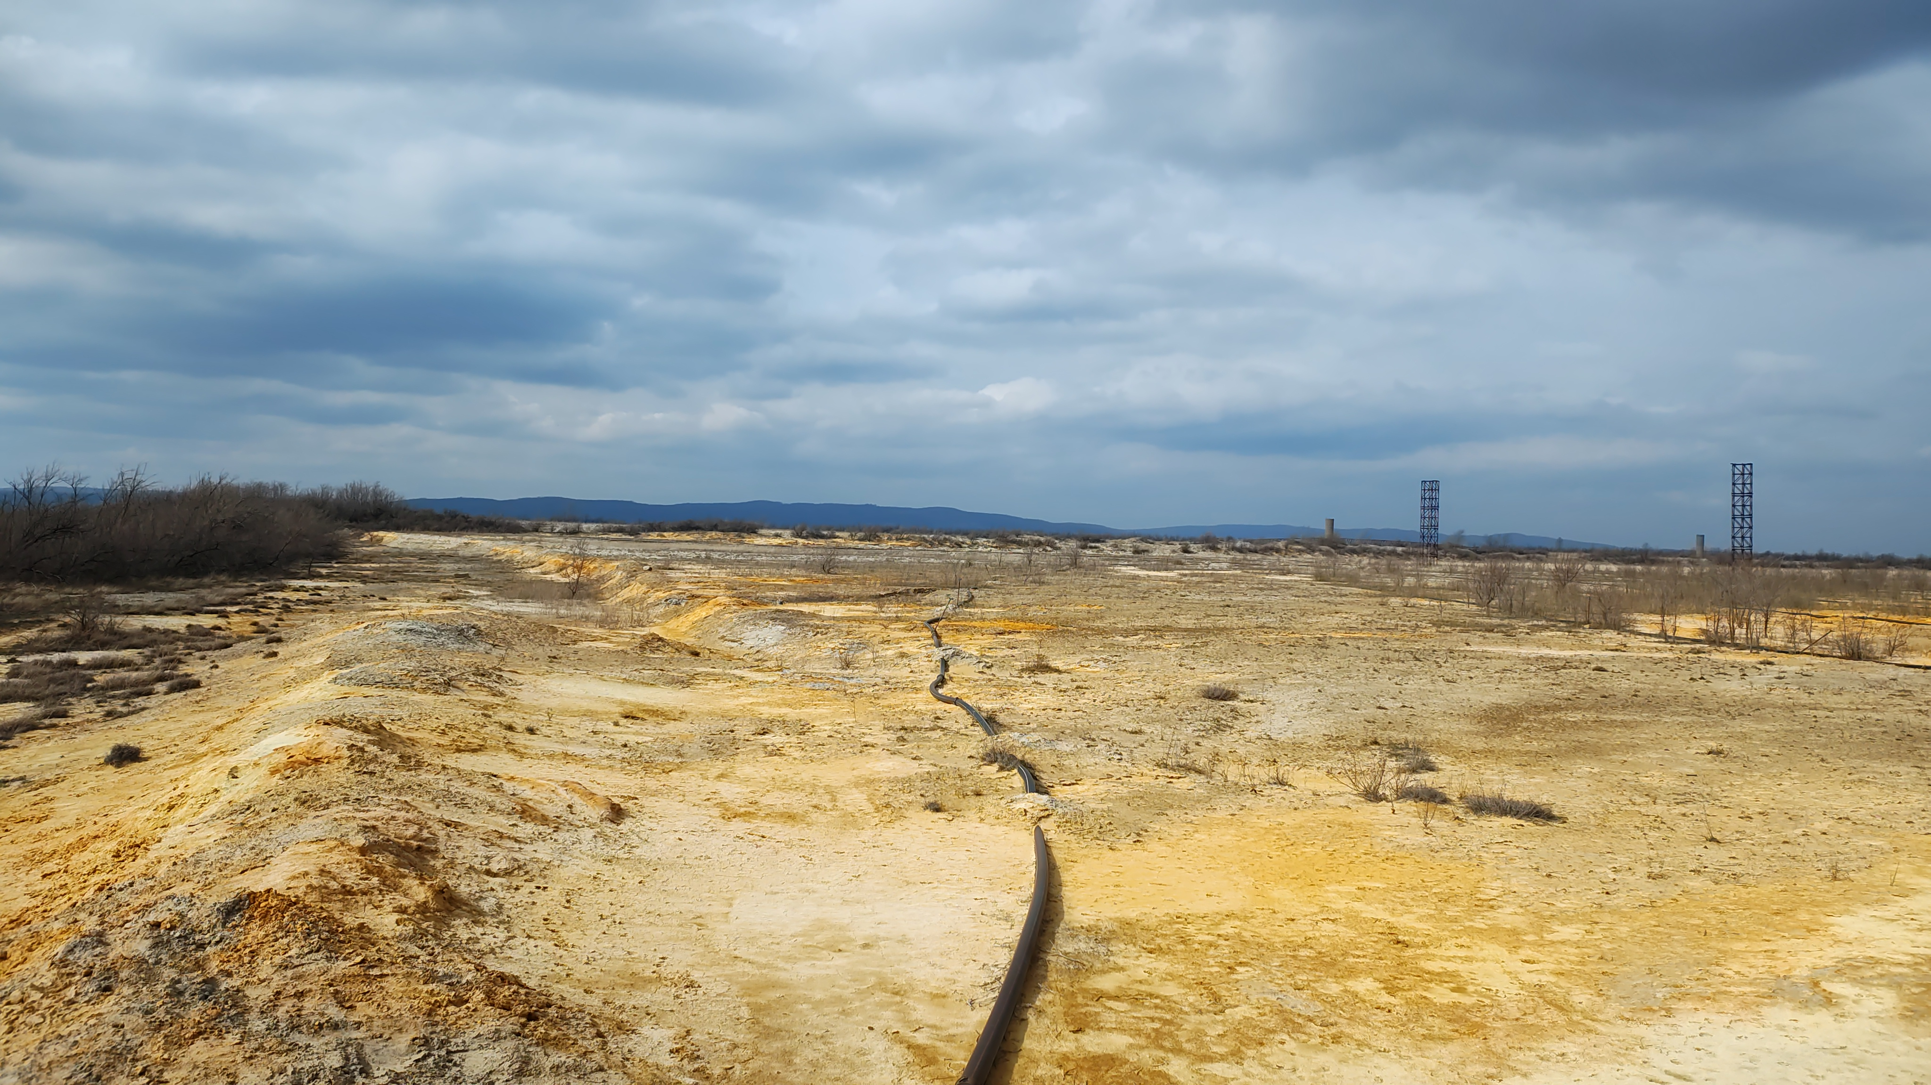
ENVIRONMENTAL CHARACTERIZATION
Mining activities can cause significant and long-lasting changes to environmental factors, particularly water and soil quality.
The copper mining area is a continuous source of pollutants due to natural geochemical processes (sulfide oxidation), wind-borne dispersion, and leaching.
Constant monitoring and the implementation of remedial measures are essential for reducing the impact and ensuring the long-term stabilization of the environment.
RORS00063

Slide 32
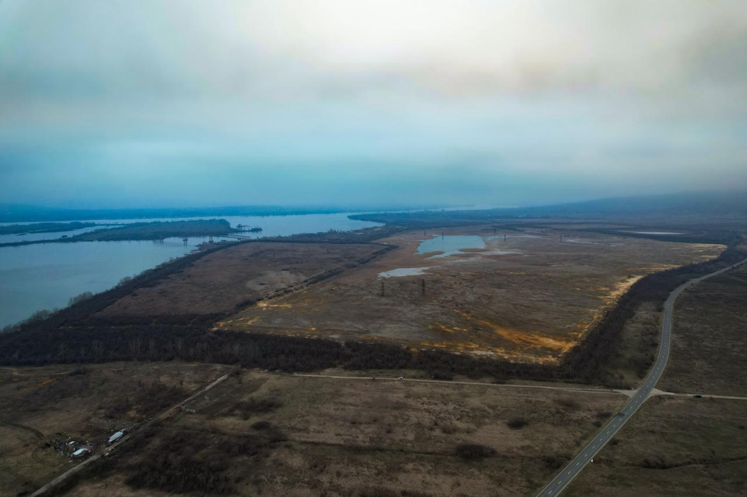



Acknowledgements
This work has been done as a part of the Project RORS00063 - “Environmental risk assessment from mining activities as a result of tailings storage in the cross-border area Romania – Serbia – ERA-MIN_RO-SRB” in Interreg-IPA Romania-Serbia Programme, financed by the European Union and co-financed by the partner states in the Programme.
Thank you!
RORS00063

