Slide 1




Environmental risk assessment from mining activities as a result of tailings storage in the crossborder area Romania-Serbia – ERA-MIN_RO-SRB
RORS00063
Procena ekoloških rizika rudarskih aktivnosti usled odlaganja jalovine u prekograničnom području Rumunije i Srbije – ERA-MIN_RO-SRB

Slide 2


Mining Activities Overview in the Bor Area and Planned Future Activities
Ivan Svrkota–Project Engineer
Mining and Metallurgy Institute Bor

Slide 3

Introduction
Key message: the Bor–Majdanpek mining region is entering a new phase of expansion and modernization.
5
active copper mines within Zijin
Veliki Krivelj, Novo Cerovo, Jama, Majdanpek, Čukaru Peki
296 kt
copper – combined production in 2025
Zijin Copper + Zijin Mining
450 kt/g
long-term copper production expansion target
combined target for Bor + Čukaru Peki
What is changing?
• Bor: a combination of surface and underground exploitation, flotation and metallurgy.
• Majdanpek: Južni i Severni revir, with the continuation of tailings disposal activities.
• Čukaru Peki: Upper zone in production; Lower zone under development.
• New projects: Borska reka, Malka Golaja and Čoka Rakita.
Key challenges
• Greater capacities and deeper exploitation.
• Greater pressure on land, tailings, water regime and traffic infrastructure.
• Increasing importance of mining waste management and reclamation.
• At the same time, the economic importance of mining for Eastern Serbia is increasing.

Slide 4
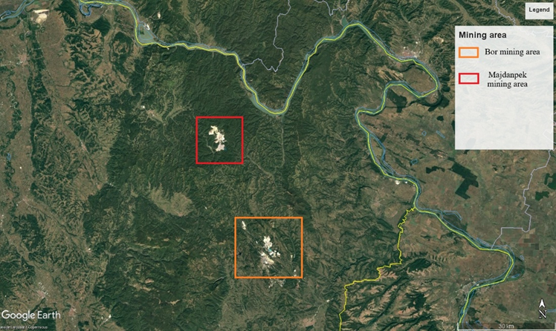
2. Spatial Framework
"Bor–Majdanpek area".
Main locations
• Bor - the main mining and metallurgical center.
• Majdanpek – large-scale surface mining and flotation.
• Čukaru Peki and Čoka Rakita - development of underground projects.
Spatial characteristics
• Bor area: copper + gold, with a long history of exploitation.
• Majdanpek area: predominantly copper, with a significant amount of gold as an accompanying metal.
• The area has been significantly transformed by mining operations and related infrastructural activities

Slide 5
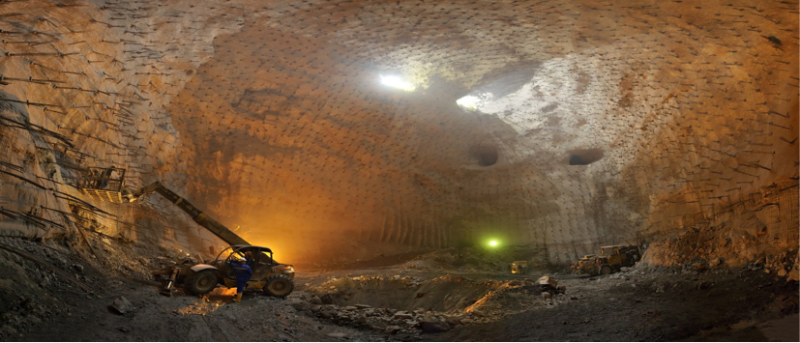
3. Active Mining Activities – Bor
Novo Cerovo
open-pit mining
copper
active production
Veliki Krivelj
open-pit mining
copper
active production
Jama
underground mining
copper
modernization + expansion
Limestone / Quarry
Open-pit mining
limestone
auxiliary raw material
Majdanpek
open-pit mining
copper + Au
active production
TIR
metallurgy
Cu + precious metals
concentrate processing
Čukaru Peki
underground mining
copper
Active production + expansion

Slide 6
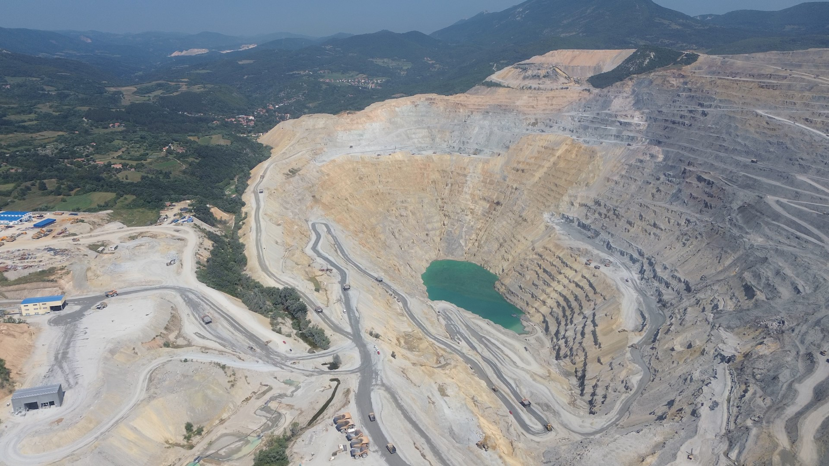
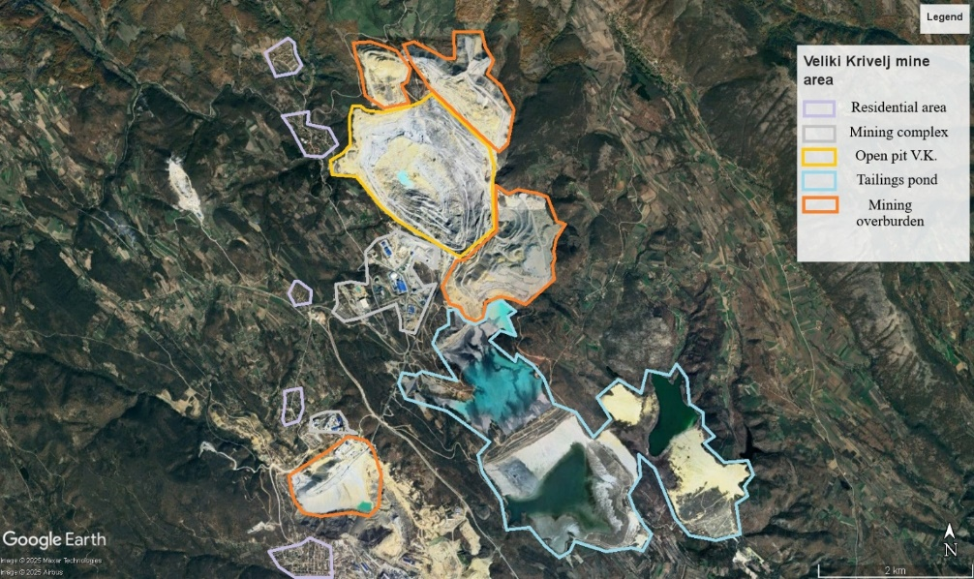
3. 1. Rudnik Veliki Krivelj
Veliki Krivelj Open Pit
• The designed annual ore processing capacity is 23.1 Mt/year
• Main mining facilities: open pit, ore preparation plant, waste-rock dumps and tailings facilities

Slide 7
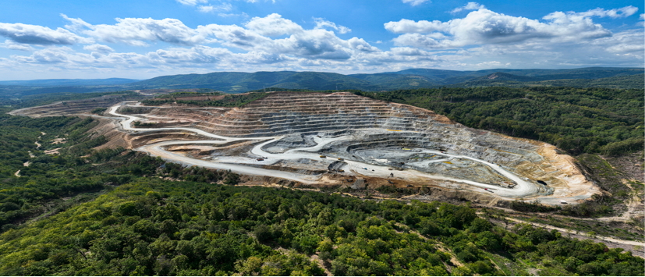
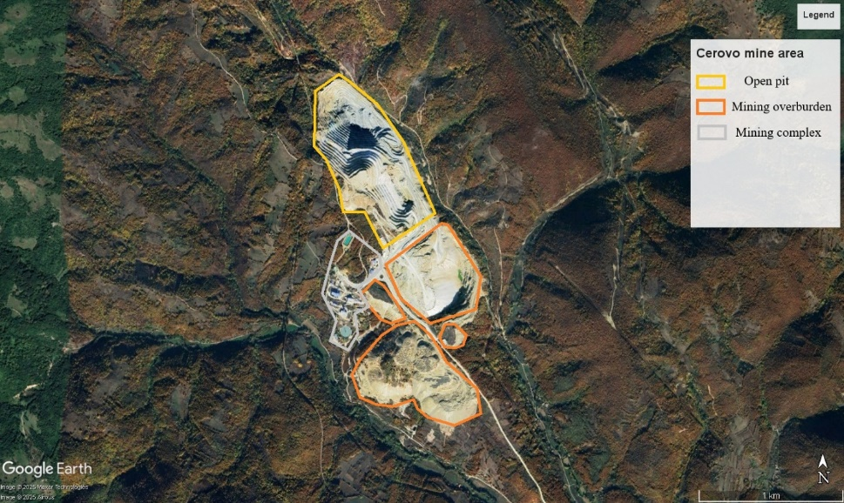
3.2. Novo Cerovo Mine
Novo Cerovo mine
• The Cerovo copper mine was discovered in the 1960s, and mining has been carried out since 1992 with interruptions, and it officially resumed production in May 2020. The projected annual processing capacity is 2.5 Mt/ore per year
• Main mining facilities: Surface mine and landfills, preparation plant

Slide 8
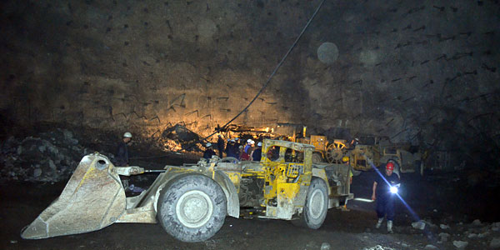
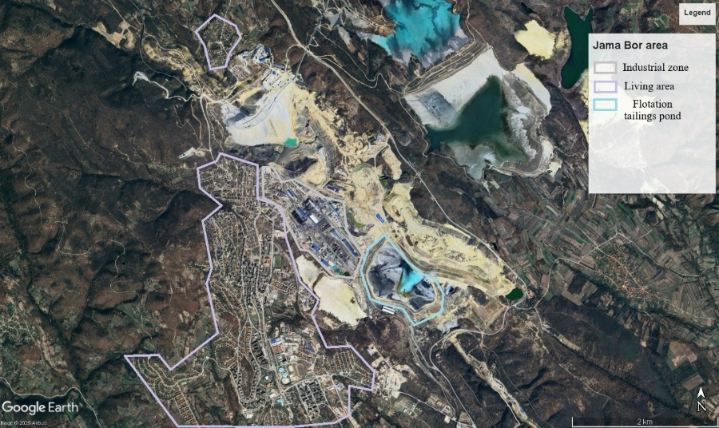
3.3. Jama Mine
Jama Mine
• The Jama mine was founded in 1903, and it is planned to dramatically increase production to 18 Mt/ore per year
• Main mining facilities: Underground facilities, flotation tailings

Slide 9
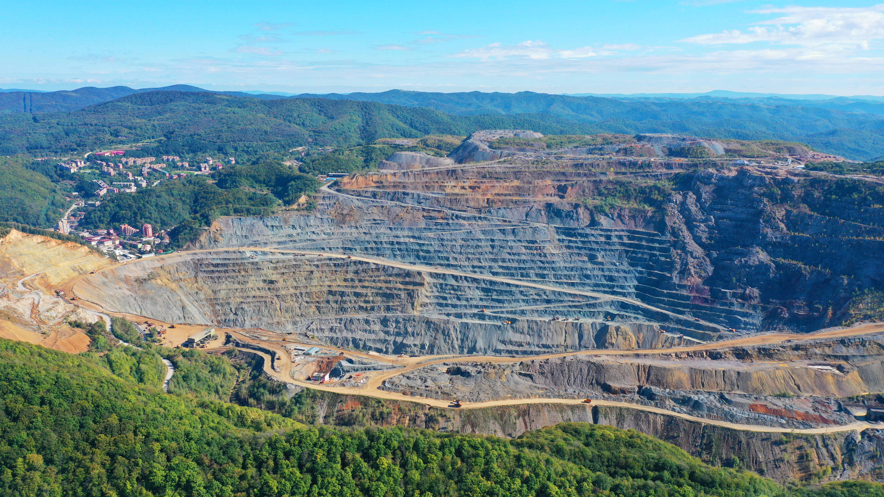
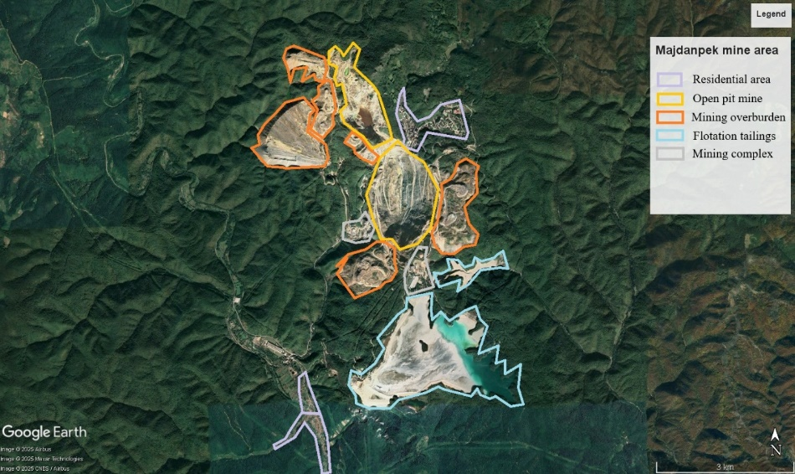
3.4. Majdanpek Mine
Majdanpek Mine
• The projected annual processing capacity is 11 Mt/ore per year
• Main mining facilities: Surface mine Južni and Severni revir, processing plant, mining overburden and flotation tailings

Slide 10
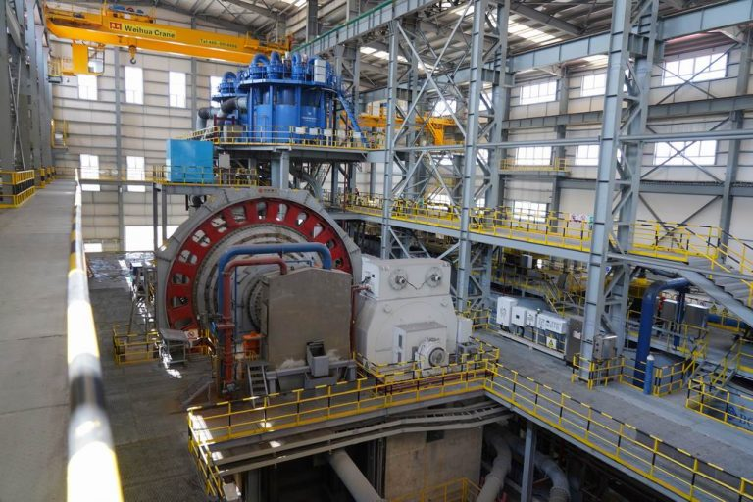
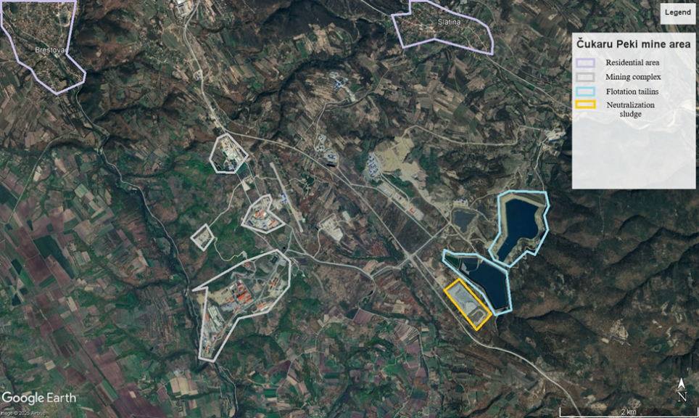
3.5. Čukaru Peki Mine
Čukaru Peki Mine
• The projected annual processing capacity is 4,95 Mt/ore per year
• Main mining objects: Undeground facilities, processing plant, flotation tailings

Slide 11
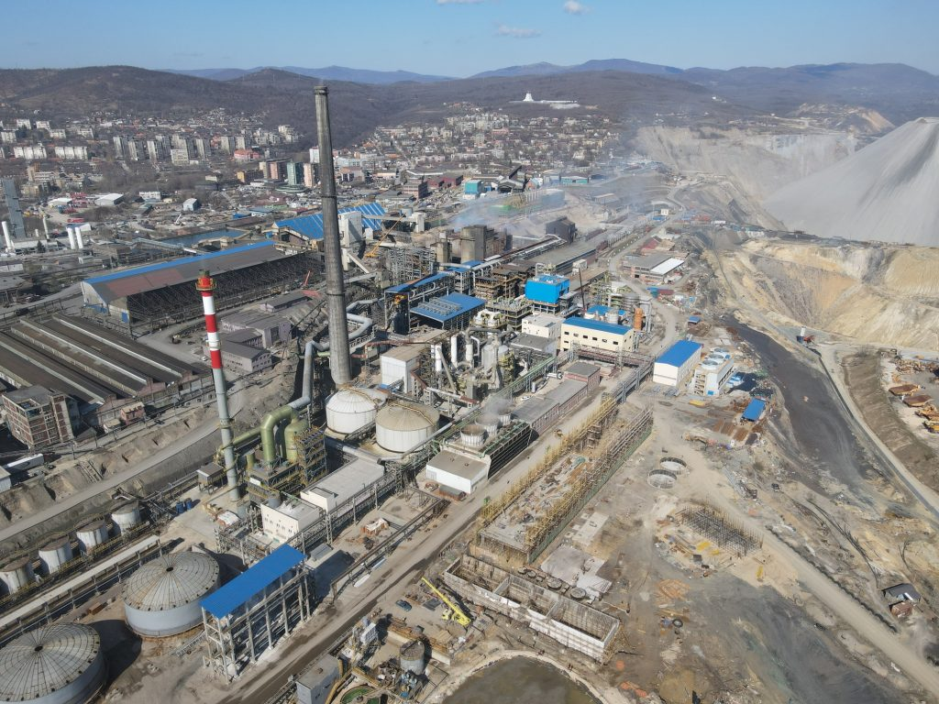

3.6. Smelter plant
Smelter
• The projected annual processing capacity is 180 000 t of copper
• Main metalurgical objects: Flash smelting furnace, converters, Electrolytic Refinery

Slide 12
4. Production Volume – 2025
Company data show a strong concentration of copper production in the Bor–Majdanpek/Čukaru Peki system.
Bor Copper
123.3 kt
Čukaru Peki
172.3 kt
Combined
296.0 kt
• Bor Copper: 123,3 kt Cu i 3,94 t Au; Čukaru Peki: 172,3 kt Cu i 5,18 t Au (100% basis).

Slide 13
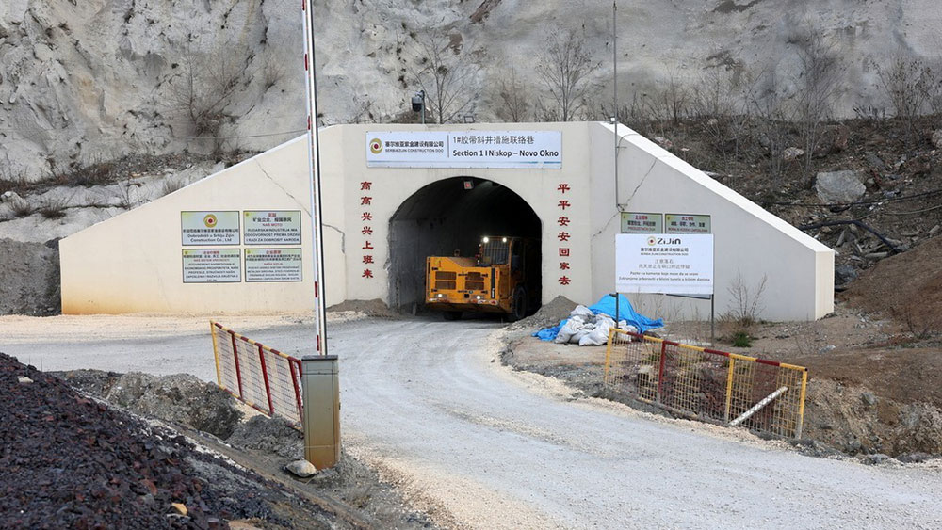
5. Future Activities – Bor: Jama and Borska Reka Deposit
Underground mining is one of the key pillars of
long-term production continuity in Bor.
5,1 km
decline to the deposit
22 years.
announced first phase
Jama mine
• The Jama mine is being modernized: moving from the cut-and-fill approach to the block caving method.
• The goal is to increase productivity and long-term use of large ore potential.
• The central element of future development is the Borska reka deposit.
Production capacity 18 Mt/ore per year

Slide 14
6. Future Activities – New Gold and Copper Projects in the Bor Area
Čoka Rakita
• Čoka Rakita (Dundee Precious Metals): high grade gold, underground project.
• 2024 PFS based on 6.6 Mt reserve with 6.38 g/t Au
• Projected processing capacity: 850,000 t/y.
• Current FS phase; the company is now citing first production in the first half of 2029.
Malka Golaja
• Malka Golaja (Serbia Zijin Mining): deposit near Čukaru Peki.
• Zijin's public data lists 144 Mt ore, 2,606 Mt Cu and 89.37 t Au.
• Drilling and preparatory works are in progress; development requires further studies and permits.
• Potentially represents a new underground mining complex in the Bor area.
Čukaru Peki – Lower Zone
• Čukaru Peki - Lower zone (Serbia Zijin Mining): deposit near Čukaru Peki.
• Phase I of the project: 14.85 Mt/year of ore; Phases II and III: 44.85 Mt/year in total, with a total processing life of 41 years.
• Preparatory works are underway; further permits are required for development.
• It represents a new underground mining complex in the Bor region.

Slide 15
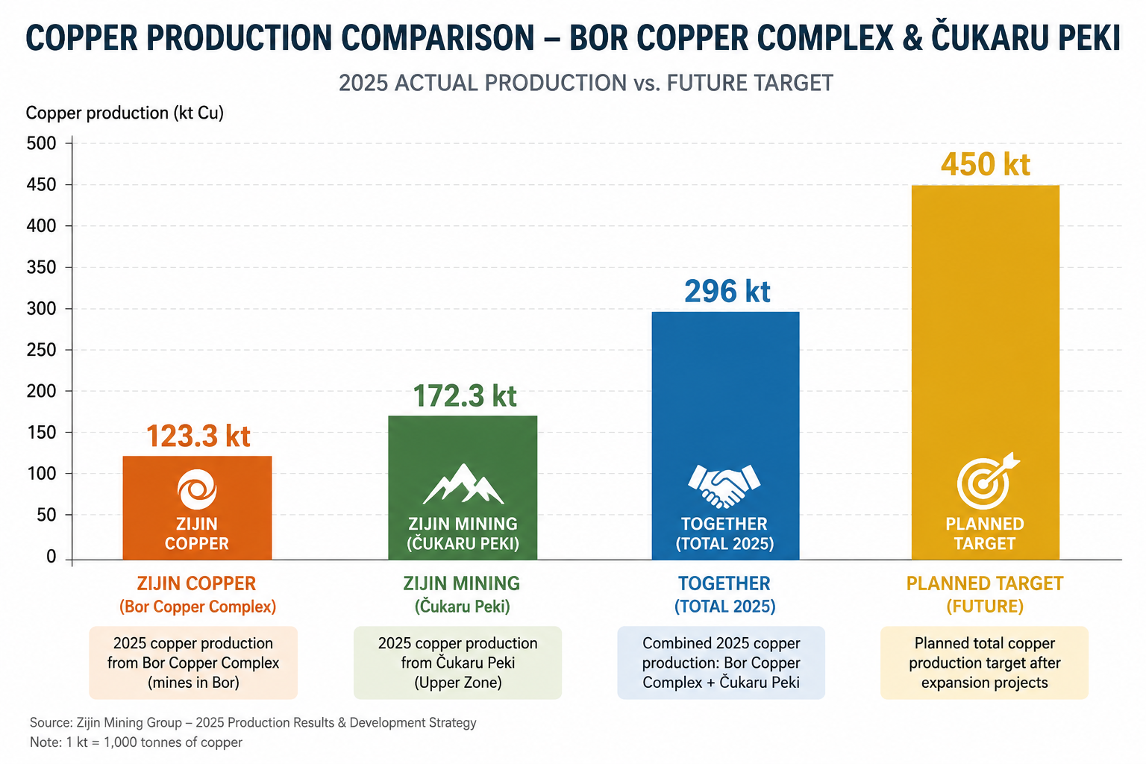
Production Volume – Starting Point for Future Development

Slide 16
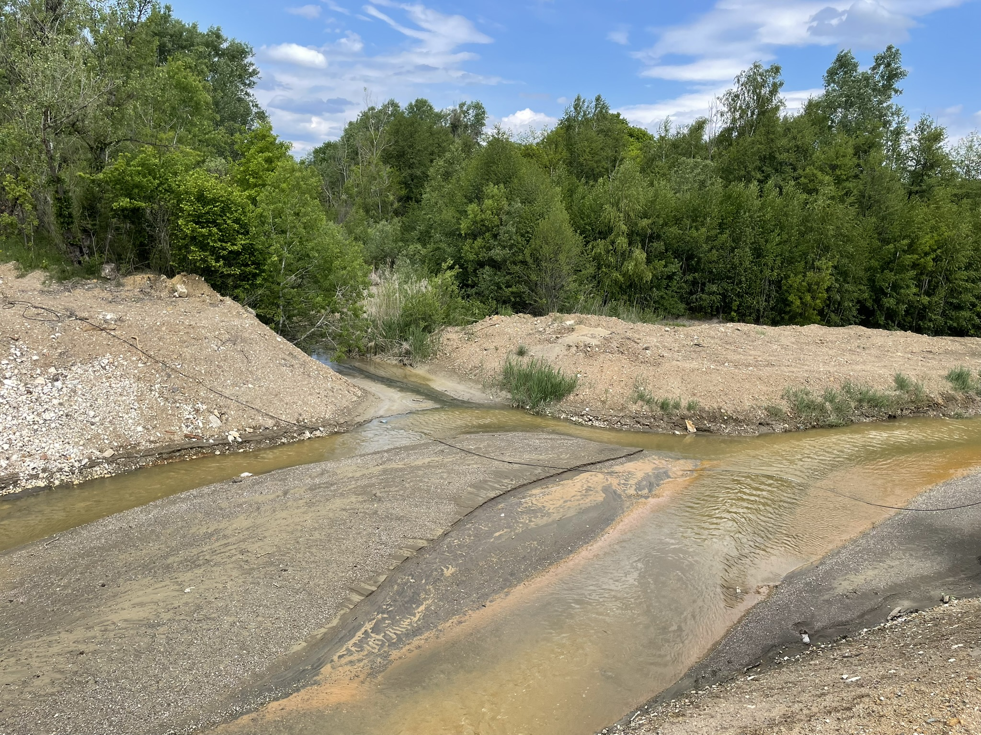
7. Environment and Spatial Planning – Key Issues for Future Development
Mining Waste
Water
tailings facilities, overburden dumps,
All tailings facilities are classified as Category A
A-category classification identifies mining waste facilities with a potential for major accidents and significant impacts on human health or the environment.
A-category facilities require enhanced safety measures, monitoring, emergency preparedness and risk management.
Open pit and underground mine dewatering
process water
protection of the Pek, Borska Reka and Timok rivers
Land
Reclamation
Open pit expansion,
infrastructure corridors,
land acquisition and resettlement
Dust reduction
Tailings revegetation
Closure and long-term maintenance
Production expansion increases the importance of integrated management of mining waste, water, land and reclamation.

Slide 17
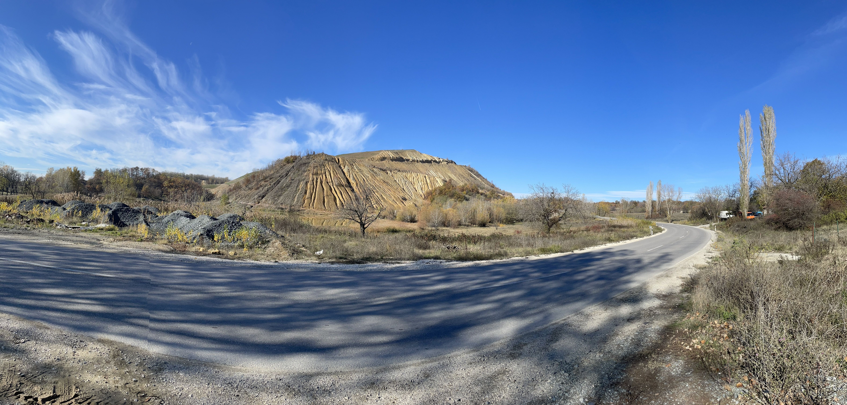
10. Supporting Infrastructure – A Bottleneck for Future Development
TRANSPORT
• declines, roads, internal transport network, concentrate and materials
ENERGY
• substations, transmission lines, power supply reliability and increased consumption
WATER
• capture, recirculation, treatment, drainage and protection of recipients
DISPOSAL
• capture, recirculation, treatment, drainage and protection of recipients
WORKFORCE
• specialized mining staff, automation and safety
LOCAL COMMUNITY
• land, traffic, noise, dust, settlements and communication with the public
Production growth depends not only on opening the orebody.

Slide 18
Conclusions
FOUR KEY MESSAGES
• Bor-Majdanpek is entering a new phase of copper and gold development.
• New projects can increase production, but also the amount of waste, water needs and spatial pressure.
• Monitoring must simultaneously follow the historical legacy and new sources of pressure.
• Environmental and spatial management must be planned in parallel with production growth - especially mining waste, water, reclamation and impact on settlements.

Slide 19


Q&A
Thank You!
Contact Information:
MSc Ivan Svrkota, Project Engineer, Mining and Metallurgy Institute Bor
Email: ivan.svrkota@irmbor.co.rs
Phone: +381 62210115
Mining Waste Dumps in the Context of Environmental Protection

